Slide 1
Improving productivity in Suriname, what we know and how to improve it
Paramaribo August 30 2017

Slide 2
Outline of the conversation
A brief story of Suriname’s economic performance
What is productivity and why do we talk so much about it?
Our preliminary estimates of productivity
Five sectors that merit special attention (no surprises here)
  Mining
  Fisheries
  Agriculture
  Tourism
  Logistics

Slide 3
A brief story of Suriname’s economic performance
Did you know that …
Since 2000 Suriname experienced an extraordinary period of economic expansion--from 2000 to 2014 GDP per capita in US$PPP grew 73.8% to US$16,141 (in Latin America only DR, TT, PE, CH and PA did better)
By 2014 Suriname growth performance was 27% higher and GDP per capita was 4.5% higher than the overall average for Latin America and the Caribbean
Suriname was accelerating income convergence to advanced economies--for example GDP per capita was 28% of the U.S. in 2014 compared to 21% in 2000

Slide 4
A brief story of Suriname’s economic performance
 | GDP per capita |  | Total growth from 2000
 | In 2014 | In 2016 | To 2014 | To 2016
Suriname | 16,141 | 14,146 | 73.8% | 60.7%
Dominican Republic | 13,314 | 15,209 | 74.6% | 87.9%
Trinidad and Tobago | 33,283 | 31,908 | 82.9% | 78.7%
Peru | 12,162 | 13,022 | 84.9% | 91.8%
Chile | 23,082 | 23,960 | 87.6% | 91.4%
Panama | 20,933 | 23,015 | 91.6% | 101.0%
Latin America & Caribbean | 15,442 | 15,418 | 58.0% | 57.9%
United States | 54,599 | 57,467 | 40.4% | 45.5%

Slide 5
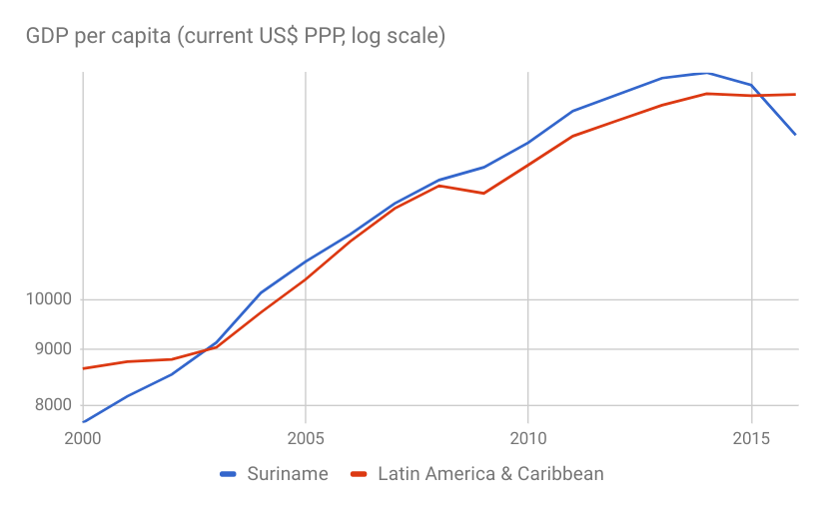
A brief story of Suriname’s economic performance
Source: World Bank Databank, World Development Indicators

Slide 6
A brief story of Suriname’s economic performance
What explains good performance since 2000?
We need to recognize that the country is slowly modernizing--local industrial capacity is slowly developing to satisfy domestic demand for food, beverages, and household chemical and health products
Significantly better fiscal and monetary policies also played a large role in the economic success since 2000
But, the country still depends on commodity exports of gold and oil

Slide 7
A brief story of Suriname’s economic performance
And this is the (recurrent) problem
When international prices of commodities dropped, the economic expansion ended in or around 2015, and the good times were not used to strengthen the underlying weakness of the economy
(almost) unbelievable change from 2011 to 2016: a negative swing of over 21% of GDP in the current account balance and over 9% of GDP in the fiscal balance; no country can sustain such a drop in revenues
the transmission mechanism is direct and has happened many times in the past, but not since 1999-2000

Slide 8
A brief story of Suriname’s economic performance
The chain reaction triggered by a drop in international prices of gold and oil
lower international prices of exports result in lower public sector revenues and Central Bank foreign currency
exposing the cost of maintaining a large public sector wage bill and the negative impact of public spending on aggregate demand, hurting local businesses
amplified by a large drop in international reserves, that forces the Central Bank to devalue the Surinamese dollar at the last possible moment
when this happens, relative prices need to adjust and inflation picks up
real income comes down, making everyone in the economy less wealthy than before. The gains of the past 15 years have not been erased since 2015, but they have been significantly eroded.

Slide 9
A brief story of Suriname’s economic performance
What can we do?
To accelerate the modernization process of Suriname government should enable and facilitate actions that would result in:
Expansion of exports in the strong and weak sectors of the economy (mining and non-mining)
Increasing value added of exports, especially in the mining sector
Strengthening value chains, particularly those related to the mining sector (increasing local content in the mining sector), agriculture, fisheries and other sectors
Acknowledging that the diversification of exports is not a strategy to diversify away from mining, but rather, a strategy to diversify exports in the mining and non-mining sector by increasing value added

Slide 10


What is productivity and why do we talk so much about it?
All the problems that we have can be presented using the concept of productivity. We, even though rich in natural and human resources, are not good enough in how we use them.
Productivity: how efficient we are in using our factors of production, and can be measured as units of output divided by units of inputs.
Formally:
And after some assumptions and mathematical simplifications:

Slide 11
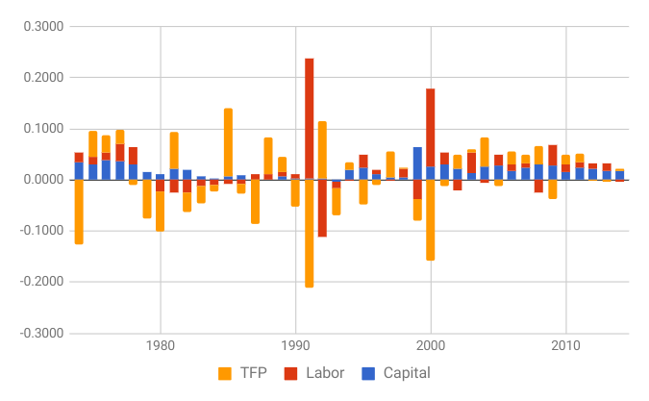
Our preliminary estimates of productivity

Slide 12
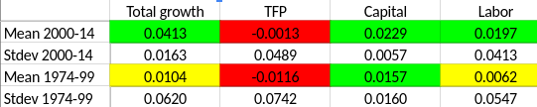
Our preliminary estimates of productivity
Our problem is that our ideas, innovation, creativity are not contributing to our growth (of course, as measured by the indicators used for estimation).
Assume: that we agree to DOUBLE our income in 10 years, that would mean that we need to grow at 7% per year. Which would mean that we need to increase our PRODUCTIVITY from -0.0013 to 2.87%. That is our challenge

Slide 13
How to operationalize programs to improve productivity
Horizontal vs vertical interventions (we need to think about both)
The problem of picking winners
The benefits from focusing on value chains for identifying industry-wide bottlenecks
Global value chains analysis
And demand matters (not just a focus on supply)
Today we will hear from experiences in the region and also Suriname specific on using the methodology of value chain for policy design and implementation.
Let’s be specific, what is a value chain?

Slide 14
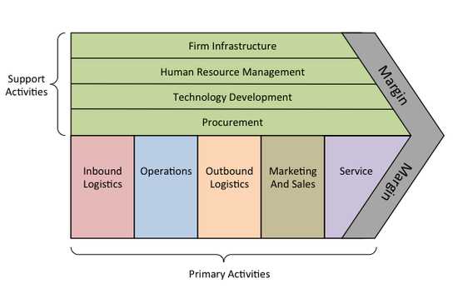
Porter’s value chain--primary and support activities

Slide 15
Five sectors that merit special attention
Our estimates of productivity help in making the argument that we need to accelerate the modernization process, and that the key is in increasing our productivity. Let me tell you some stories about bottlenecks
Mining--Staatsolie and Newmont are working on increasing local content
Fisheries--fishing licenses; people skills to work in a modern, almost fully automated, factory; access to working capital
Agriculture--import and exports costs in time and money; skills; import 90% of procurement (only boots and machetes are produced locally)
Hotels--10% is procured by local producers (linen, shampoo, beds, furniture, fixtures, TVs and more are imported)
Logistics--all packaging is imported from abroad

