Slide 1
ENHANCING
PRODUCTIVITY AND GROWTH
IN THE CARIBBEAN
Jason Cotton
Economist, Caribbean Development Bank
Roundtable: Productivity and Economic Growth:
The Case of Suriname
Competitiveness Unit Suriname
Paramaribo, August 30, 2017

Slide 2
Outline
Highlights of the Study
Recommendations
CDB Support

Slide 3
Pillars for enhancing growth and development
Development of a “knowledge economy”
Foreign Direct Investment
Information and Communications Technology
Research and Development
Clustering
Innovation

Slide 4
FDI promoting policies
Improving overall business climate
Doing business
Human resource
Corruption
Governance
Logistics
FDI Promoting Policies
Removing or reducing challenges to investors
Taxation treaty
Citizen by Investment Program
Investment Promotion Agencies
Data / information availability
Financial measures to stimulate FDI
Alternative type of tax holidays
Removal or exemption of tax duties
Removal or exemption of import and export duties
Grants

Slide 5
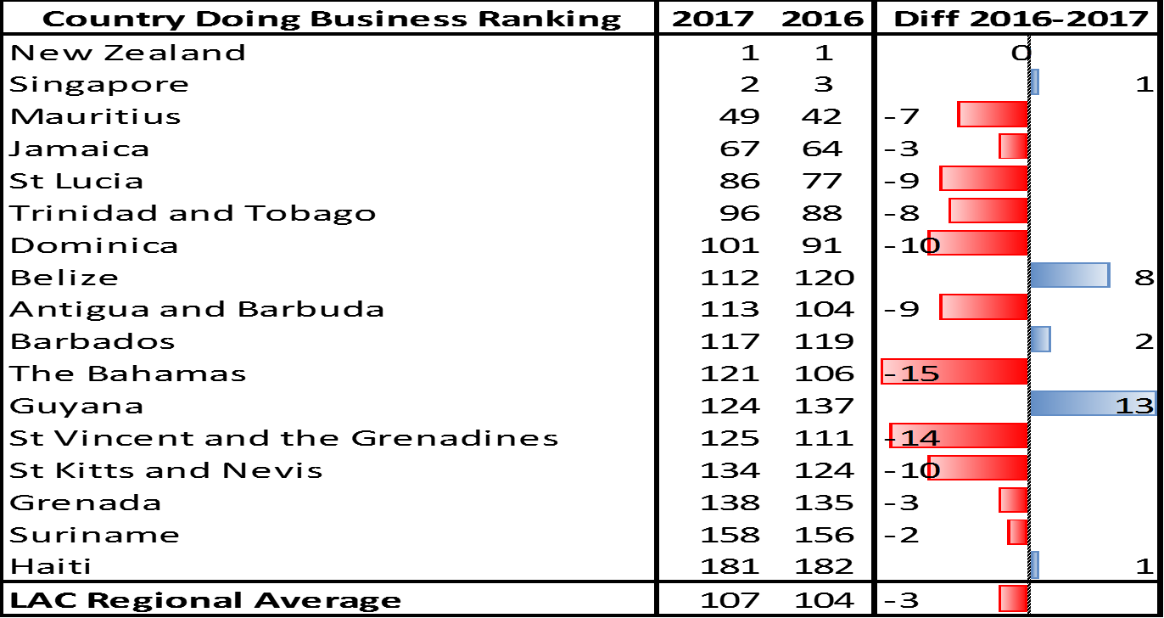
World Bank’s
Ease of Doing Business

Slide 6
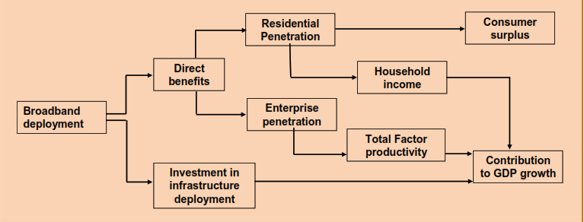
Broadband and productivity
Broadband Economic Impact
Source: ITU 2012.

Slide 7
Development of
RD & I in the Caribbean
Collaboration between Public and Private Sector and Research Centers
Financing
Regional / National Innovation System (NIS)
Internal Capacity

Slide 8
Cluster development
Clusters in the Caribbean
Music (Jamaica)
Yachting (Saint Lucia)
Pepper Sauce (Trinidad & Tobago)
Gold Jewellery (Guyana)

Slide 9
Growth strategy
Foreign Direct Investment
Clusters
MSME Development
Innovation
Research & Development
Technological Transfer
Knowledge Economy
ICT
Broadband

Slide 10
Selected
Recommendations
A regional strategic plan be developed and implemented to improve the “ease of doing business”;
The provision of incentives and financial support to boost R&D and innovation and cluster development and access ICT, while at the same time reducing regional competition in such areas;
Engagement with the Caribbean Diaspora as a source of skills and finance;
Reduction in the cost of ICT services in the region to enable access and affordability by MSMEs;
Strengthen the human capital base of the region by developing a strategic HRD which can be implemented in collaboration with regional and national educational and training institutions;
Strengthening the regulatory framework
Standards be set for the Citizenship for Investment programmes;
Greater use be made of foreign-local partnerships; and
Work be undertaken with CAIPA and Caribbean Export to develop a regional investment promotion strategy to boost innovation and technological transfer.
Strengthening the regulatory framework governing R&D, intellectual property, tax competition, access to finance and cluster development;
Extension of the range of institutions involved in innovation and productivity in the region. At present there are only four institutions directly promoting productivity in the region: Barbados, Jamaica, St. Lucia and Trinidad and Tobago;
Incorporation of elements of this study in national and regional (CARICOM and OECS) strategic plans which have been formulated in the region. Some countries have developed explicit growth strategies (e.g. Barbados, Jamaica and Trinidad and Tobago) and the OECS has a Growth and Development Strategy. These plans need to develop explicit initiatives for the four elements discussed in this study.

Slide 11
Enhancing productivity and growth in Suriname
How the CDB can assist
1
Technical Assistance for the preparation of an MSME study.
2
Strengthening the human capital base.
3
Improving trade and Market access.
4
Street Light Retrofit project.
5
Establishing performance management and delivery units.
6
Public Private Partnership awareness building and support.

Slide 12

Thank you

