Slide 1
Productivity Experiences in South Africa and the role of Productivity SA
Ms Vanessa Phala,
Senior Specialist, Employers' Activities
International Labour Organization Decent Work Team and
Office for the Caribbean
Port of Spain

Slide 2
South Africa – Brief Context
One of the biggest economy in the Continent
Growth rate continues to decline over the years
2011 – 2015
Population 51m – 54m
Economic growth 3,2% - 1,3%
Unemployment 24% - 25% (65% youth)
GDP per capita (USD) 8,656 – 5,994
Exchange rate (USD) 8 – 15,5
Key sectors of the economy and contribution to GDP
Manufacturing – 15,2%
Mining – 4,9%
Agriculture – 2,2%
Construction – 3%
Finance, real estate and Bus services 21,5%
Notes:
The mining industry and the recent labour unrest

Slide 3
Productivity and Competiveness
According to the recent The Global Competitiveness Index, improvements in “technological readiness” helped South Africa reverse a four-year decline. RSA is now at position 49/140 countries, back into the top 50
The indicator measuring efficiency in the labour market also improved
Some challenges are still being experienced in the following areas:
co-operation in labour-employer relations
hiring and firing practices
flexibility of wage determination
linkage between pay and productivity
Competitiveness is defined as the set of institutions, policies and factors that determine the level of productivity of a country, using data covering 12 categories:
institutions, infrastructure, macro-economic environment, health and primary education, higher education and training, goods market efficiency, labour market efficiency, financial market development, technological readiness, market size, business sophistication, and innovation.
The country experienced a decline in the following categories:
Institutions – corruption and the rule of law
Financial Market
Education – quality basic education (math and science)

Slide 4
Productivity and Competiveness
According to the recent The World Competitiveness Ranking 2015, South Africa's competitiveness ranking is 53/61 countries
This is in relation to in relation to the facts and policies that shape the ability of a nation to create and maintain an environment that sustains more value creation for its enterprises and more prosperity for its people.
The WCI measure competitiveness in relation to four competitive factors: namely;
Economic Performance
Government Efficiency
Business Efficiency
Infrastructure
The biggest underperformance for South Africa, is in relation to government efficiency. According to the Report, the following factors contributed to this problem
1. State intervention in business activities
2. Government have not provided macroeconomic that are predictable to minimize the external risks for economic enterprise.
3. Government have not been flexible in adapting its economic policies to a changing international environment.
4. Government should provide a societal framework, which promotes fairness, equality and justice while ensuring the security of the population?????

Slide 5
Productivity and Competiveness
According to the recent The Doing Business Report 2015, South Africa is ranked 43/189 countries in terms of ease of doing business.
The following indicators are used to measure the quality of business laws and related legal institutions:
Starting a Business
Dealing with Construction Permits
Getting Electricity
Registering Property
Getting Credit
Protecting Minority Investors
Paying Taxes
Trading Across Borders
Enforcing Contracts
Resolving Insolvency
2015 Findings
On average, starting a private company in South Africa requires 6 procedures, 53 days and costs 0.3% of income per capita.
Dealing with construction permits takes on average of 17 procedures, 111 days and costs 1.03% of the warehouse value—which is more complex than the OECD high-income economies’ average.
Notes:
Starting a business: The average time is almost 6 times longer than in the average OECD high-income economy.

Slide 6
Productivity and Competiveness
The Doing Business Report 2015 – Continues….
2015 Findings
Obtaining a new electricity connection for a business takes on average 5 procedures, 141 days, and costs 472.8% of income per capita. The number of procedures is at par with OECD high income economies but the process I almost twice as long and much more expensive—the OECD high-income average cost is just 73.2% of income per capita.
Registering property takes on average 8 procedures, 32 days and costs 6.3% of the property value. It is more cumbersome and more expensive than OECD high-income economies, where it takes on average 5 steps, 24 days and costs 4.2% of property value.
Notes:
Obtaining a new electricity connection : we recently experience a number of load shedding due to high demand and low supply

Slide 7
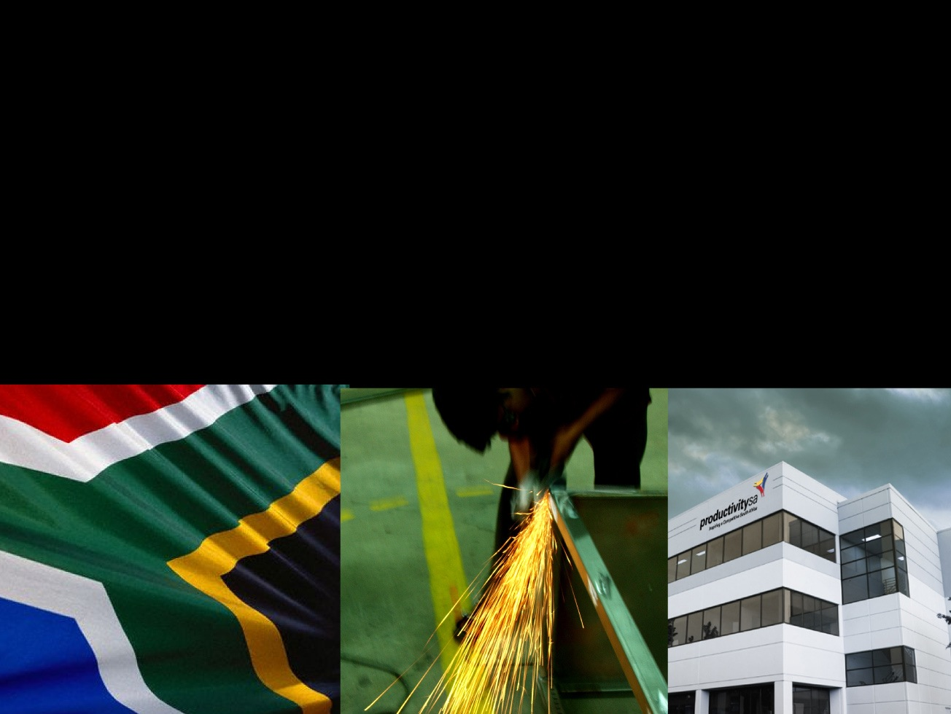
WHO IS PRODUCTIVITY SA
Vision: To lead and inspire a productive and competitive South Africa.
Mission: Improving the productivity of South Africa by diagnosing, advising, implementing programmes, monitoring solutions and evaluating progress aimed at improving South Africa’s competitiveness.

Slide 8
Structure and Governance
STRUCTURE
Established in 1969
Public Entity in terms of Employment Services Act 2014 reporting to Minister of Labour
Tripartite organization – Board drawn from Government, Business & Labour
ORGANIZATIONAL ARRANGEMENT
Head Office (Johannesburg)
2 regional offices (Durban, Cape Town)

Slide 9
Productivity SA: Employment Services Act
Productivity SA is established in terms of the Employment Services Act
Functions of Productivity South Africa
(a) to promote a culture of productivity in the workplace;
(b) to develop relevant productivity competencies;
(c) to facilitate and evaluate productivity improvement and competitiveness in workplaces;
(d) to measure and evaluate productivity in the workplace;
(e) to maintain a data-base of productivity and competitiveness systems and to publicise these systems;
(f) to undertake productivity-related research;
(g) to support initiatives aimed at preventing job losses; and
(h) to perform any other prescribed function.
Notes:
Productivity SA has a strong research capability, annual and quarterly reports are released which are used to inform policy decisions

Slide 10
Productivity SA – Core Functions
Promoting a culture of productivity in workplaces,
Facilitate and evaluate productivity improvement and competitiveness in workplaces, and,
Support initiatives aimed at preventing job losses.

Slide 11
Productivity SA Board
Mr Mthunzi Mdwaba - Chairperson of the Board
Board Member (Organised Business - NAAMSA)
Board Member (Organised Business - NAFCOC)
Board Member (Organised Labour - SACCAWU)
(Organised Labour - HIAWU)
Board Member (Government - Department of Trade and Industry)
Board Member (Government – Department of Labour)
Board Member – Proxy (Government – Department of Labour )
Board Member – Ex-Officio (Government - Unemployment Insurance Fund)

Slide 12
The Board
The Board is responsible for the management and control of the affairs of Productivity South Africa.
The members of the Board hold office for a period of five years and are eligible for reappointment upon expiry of their terms of office, but may not serve for more than two consecutive terms of office.

Slide 13
Productivity SA - Journey
PSA journey dates back to 1969 when the National Productivity Institute was established
Between 1971 – 1990, the Institute conducted a number of sectoral productivity measurement studies in the following sectors:
Clothing;
Agriculture;
Construction;
Printing industry;
Pharmaceutical industry
These also included a productivity survey of 8 municipalities which led to the establishment of a permanent productivity unit for local authorities

Slide 14
Productivity SA - Journey
Between 1998 – 1999 a transitional period took place post the 1994 first democratic elections. A new Tripartite Productivity Advisory Council was appointed
In 2000 the new Council initiated projects to prevent job loses and declining employment opportunities following the 1997 financial crisis
The Work Place Challenge was launched as an initiative between NEDLAC and the DTI to support and encourage work place change and help industries re-entry into the global market
By 2001 – 2003 A transformation and reconfiguration of the NPI took place to align with government priorities

Slide 15
Productivity SA - Journey
In 2004, the NPI launched Productivity Capacity Building Programme for SMMEs
In 2005 NPI launched partnership with Asia Productivity Organisations
Between 2006 – 2007 – Period of major achievements and growth
The NPI affirmed itself as the leader in productivity and increasing enterprise competitiveness
Re-branding of NPI to Productivity SA
In 2008, Productivity SA hosted the world Productivity Congress for the first time in Africa
2009, Productivity SA celebrated 40 years
2010- 2015 – productivity research and data collected to continue influencing policy and programme interventions
Productivity Awards remains one of the biggest initiative to raise awareness about the potential role of productivity in growing and developing the economy

Slide 16
Productivity SA- STRATEGIC THRUSTS
Promote and support SME and cooperatives productivity capabilities (Productivity Organisational Solutions Programme)
Promote Enterprise productivity and competitiveness (Workplace Challenge Programme)
Saving jobs and creating a conducive environment for economic growth (Turnaround Solutions Programme) launched 16 years ago
Generate productivity related research to influence policy debates and decision-making by investors
Creating awareness of Productivity in the economy

Slide 17
THE Work Place Challenge CONCEPT
Improved Productivity & Competitiveness
Collaboration
Best Practices
Sharing lessons

Slide 18
THE Work Place Challenge ACHIEVEMENTS
The programme is implemented over a 2 year period in industrial clusters, under the guidance of a dedicated WPC Change Facilitator, and involves small groups of enterprises in a process of implementing the basic principles of Continuous Improvement
The basics include:
World-class Management System,
Goal Alignment,
Cleaning & Organising (5S),
Teamwork,
Leadership and Green Productivity (Improving carbon, water, chemical, paper and human energy footprint).
The cluster participants are also facilitated to share their lessons learnt and to learn from one another.
Over the past 15 years the Workplace Challenge programme, Productivity SA’s Best Operating Practice/world-class manufacturing programme, has brought many positive changes to the lives of more than 50 000 employees, of 256 companies

Slide 19
TURN AROUND SOLUTIONS
Turnaround Solutions is an intervention which delivers turnaround and contingency plans for companies that are faced with the risk of financial ruin, extensive job loss and sustainability challenges.
Phase 1: Turnaround Solutions
Phase 3: Job creation
Phase 2: Managing retrenchments

Slide 20
OUTCOMES OF TURNAROUND SOLUTIONS
Jobs security
Improves Productivity and profitability of enterprises
Improves company performance through better marketing, financial strategies, management, HR and Operations
Effective labour-management collaborations
Early Warning systems to detect signs of decline

Slide 21
BENEFITS OF PRODUCTIVITY INTERVENTIONS IN SMEs
Increase productivity levels amongst small–medium enterprises.
Build the productive capabilities of small-medium enterprises.
Improves Productivity and profitability of enterprises.
Quality problems are sorted out leading to better quality products.
Delivery problems are attended to leading to a more reliable delivery.
Waste is reduced leading to improved cost, productivity and competitiveness.
Shop floor employees acquire skills and competence, leading to a better morale, loyalty and performance .

Slide 22
Productivity Movements in Africa
The Pan African Productivity Association (PAPA) was established in 1990 through Declaration by Botswana, Ethiopia, Ghana, Ivory Coast, Nigeria and South Africa delegates at the World Productivity Congress held in Malaysia.
Objectives of PAPA are:
To provide a forum for promoting and sharing ideas & experience on strategies, techniques & practices for productivity enhancement
To encourage & nurture the development of a productivity culture in African economies
To foster co-operation & collaboration between national productivity organisations & other related bodies in Africa & Internationally
To facilitate the establishment and development of National Productivity Organisations, centres or institutions in Africa
To facilitate and promote tripartism in enhancing productivity.
Productivity SA serve as the Secretariat of PAPA.

Slide 23
AU Productivity Agenda 2010/2016 and Programme of Action
The Ouagadougou 2004 Declarations called for increased productivity.
At the Labour and Social Affairs Commission of the African Union in 2009, the 2010/16 Productivity Agenda for Africa was adopted
The adoption of PAPA to serve as the technical wing to implement the Productivity Agenda for Africa.
Accelerate the implementation of productivity agenda for Africa.
Formalise the setting up of a Continental Productivity organisation to spear-head the productivity movement in Africa.

Slide 24
Programme of Action for the Agenda
Develop a platform for creating collaborative linkages with development bodies to enable Africa to benefit from best practices in productivity and competitiveness.
Develop Communication Strategy to promote productivity and competitiveness culture based on documented trends and success stories in Africa
Develop Productivity capacity building programmes for MSMEs, agricultural and public sector & implemented at Regional Economic Bodies
Development of Productivity & Competitiveness Index for Africa.

Slide 25
Conclusion
Increasing productivity requires a long term strategy
Sector specific interventions are useful
Research and data collection is critical for evidence base policy making
Collaborative approach is the key at both national (tripartite) and industry (bi-partite) levels
Long journey which requires continues dialogues and innovation

Slide 26
THE END
Ms Vanessa Phala,
Senior Specialist, Employers' Activities
International Labour Organization Decent Work Team and
Office for the Caribbean
Port of Spain

