Slide 1
General Overview of Intellectual Property (IP) and the Role of effective IP Asset Management in Enhancing the Competiveness of SMEs
Paramaribo, Suriname
April 29, 2016
Carol Simpson
Head, Caribbean Section, Regional Bureau for Latin America and the Caribbean, WIPO

Slide 2
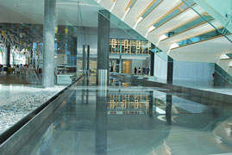

Basic Facts about WIPO
WIPO’s Mission:
Our mission is to lead the development of a balanced and effective international intellectual property (IP) system that enables innovation and creativity for the benefit of all.
Status: An int’l intergovernmental organization - United Nations specialized Agency
Member States: 188 and 350+ accredited observers
Staff: 1300 from 120 countries
Treaties Administered: 26
http://www.wipo.int/members/en/ http://www.wipo.int/about-wipo/en/history.html

Slide 3
The World Intellectual Property Organization (WIPO): A Brief History
  1873 - international exhibition of inventions in Vienna
  1883 marked the birth of the Paris Convention for the Protection of Industrial Property
  1886 Berne Convention for the Protection of Literary and Artistic Works
  1893: The United International Bureaux for the Protection of Intellectual Property (BIRPI) was set up in to administer the Paris Convention and Berne Convention.
  1967: The Convention Establishing the World Intellectual Property Organization (WIPO) was signed. WIPO replaced the BIRPI
  1974: WIPO became a specialized agency of the United Nations with a mandate to administer IP matters
  1995/6: Cooperation Agreement with World Trade Organization (WTO) (TRIPS Agreement)

Slide 4

Milestones : 1883 to 2016
2012 -16
2009
2002
STLT
1995
Internet Treaties
1989
TRIPS
1974
Madrid Protocol
1970
UN Agency
PCT
1967
WIPO established
WIPO Convention
1960
1925
BIRPI moves to Geneva
1893
Hague Agreement
BIRPI
1891
1886
Madrid Agreement
1883
Berne Convention
Paris Convention 1884 with 14 MS
http://www.wipo.int/about-wipo/en/
WIPO IP Handbook ch. 1 pages 4 to 12

Slide 5
Treaties Administered by WIPO (26 including WIPO Convention) http://www.wipo.int/treaties/en/
IP Protection | Global Protection System | Classification
Beijing Treaty on Audiovisual Performances Berne Convention Brussels Convention Madrid Agreement (Indications of Source) Marrakesh Treaty (VIP) Nairobi Treaty Paris Convention Patent Law Treaty Phonograms Convention Rome Convention Singapore Treaty on the Law of Trademarks Trademark Law Treaty Washington Treaty WCT WPPT | Budapest Treaty (P) Hague Agreement Lisbon Agreement Madrid Agreement (Marks) Madrid Protocol PCT | Nice Agreement(Marks) Strasbourg Agreement(Patents) Locarno Agreement (Designs) Vienna Agreement (figurative elements of marks)

Slide 6
Global IP Systems
  WIPO manages four global services
  Patent Cooperation Treaty (PCT)
  Madrid System for International Registration of Marks
  Hague System for International Registration of Designs
  WIPO Arbitration and Mediation Center

Slide 7
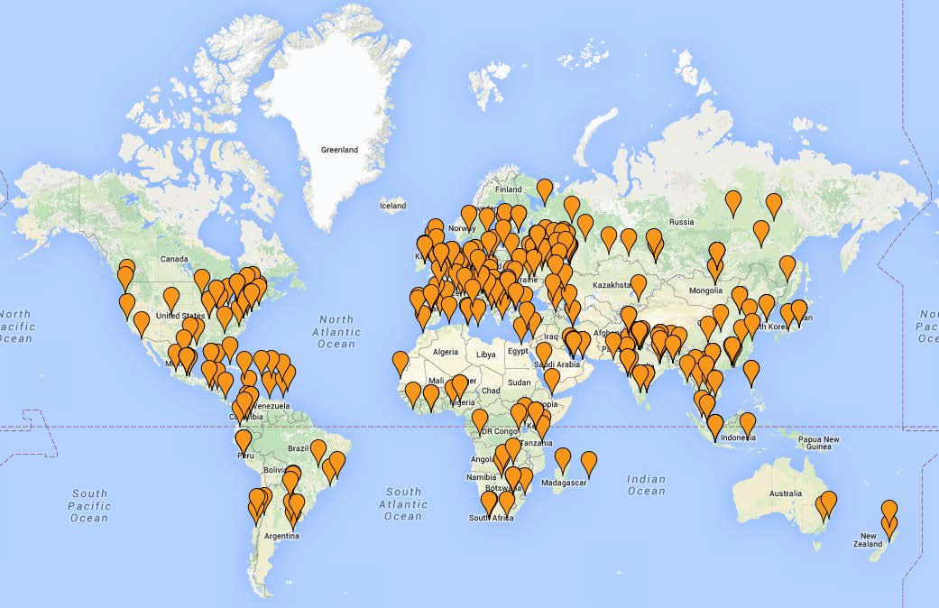
GLOBAL IP SYSTEM
349 World IP Day events reported in 105 countries around the world in 2015

Slide 8
How we do it?
Technical infrastructure
Global IP systems & services
How we do it?
Development Cooperation
Normative development
Policy Studies

Slide 9
What is Intellectual Property (IP)?
  Copyright
  Trademarks
  Patents
  Utility or Petty/Design Patents
  Industrial Designs
  New Plant Varieties
  Geographical Indications

Slide 10
What is Intellectual Property ?
INTELLECTUAL
PROPERTY RIGHTS
Industrial Property
Trade Marks
Patents
Industrial Designs
Geographical Indications
Copyright and
Related Rights

Slide 11
What is Intellectual Property?
IP Refers to creations of the mind: inventions, literary and artistic works, and symbols, names, images and designs used in commerce
  Also includes
  traditional knowledge, traditional cultural expressions, genetic resources
  Trade secrets

Slide 12
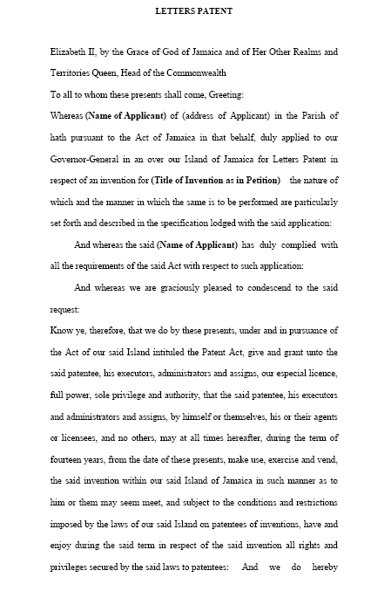

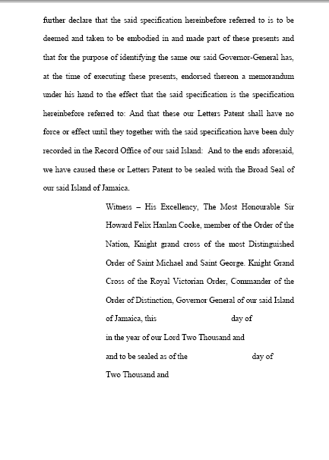

Patents

Slide 13
What is a Patent?
PA – “a title granted to a patentee by the Registrar, which protects the patentee’s right in an invention”
An exclusive right granted for an invention – a product or process that provides a new way of doing something, or that offers a new technical solution to a problem

Slide 14
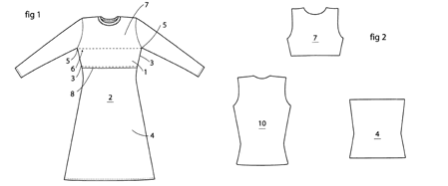
Example of a Patent
Mia Seipel’s Breastfeeding shirts http://www.prv.se/en/patents/why-apply-for-a-patent/examples-of-patents/breastfeeding-shirts/

Slide 15
RIGHTS OF AN INVENTOR
An Inventor or Patent owner has the right to decide who may or may not use the patented invention for the period that the invention is protected.
The Inventor may license or sell the invention on mutually agreed terms
On expiration of a Patent the protection ends and the invention enters the public domain,
the invention is then open for commercial exploitation by others.

Slide 16
Legal Framework
International Instruments
  Paris Convention for the Protection of Industrial Property (Suriname 1975)
  Patent Cooperation Treaty (PCT)
  The U.S., with 57,385 international patent applications, remains the largest user of the PCT, followed by Japan (44,235 PCT filings) and China (29,846).
National Legislation

Slide 17

Grant and Duration
Requirements for Grant
  (a) the invention is new;
  (b) it involves an inventive step; and
  (c) it is capable of industrial application
Duration:
  In most jurisdictions 20 years – Non renewable
Stock Image – Registration http://www.fotosearch.com/CSP390/k3903493/

Slide 18
Utility Models or Petty Patents

Slide 19
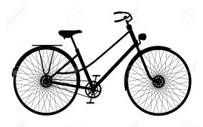

Utility Model
Equivalent to patent protection without examination (no inventive step)
  No globally accepted term
            Uma Suthersanen, Utility Models and Innovation in Developing Countries, February 2006, UNCTAD-ICTSD Project on IPRs and Sustainable Development.
  Technology design (closer to industrial designs)
Shorter duration than patents – varies from 5 to 15 years

Slide 20
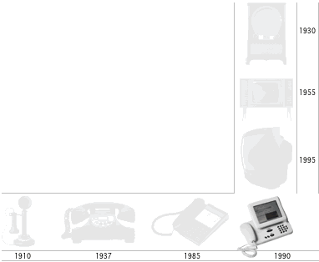
Industrial Design

Slide 21
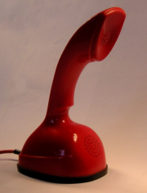
What is an Industrial Design?
“An industrial design refers to the ornamental or aesthetic aspects of an article. A design may consist of three-dimensional features, such as the shape or surface of an article, or two-dimensional features, such as patterns, lines or color.”
What is Intellectual Property? - WIPO Publication No. 450(E)
Figure 12. Ericsson Ericofon, 1956-1972. (Wikipedia Commons, Public Domain)

Slide 22
Legal Framework
International Framework
  Hague Agreement Concerning the International Registration of Industrial Designs (Suriname 1975)
National Legislation

Slide 23
Registration and Duration
In many jurisdictions
  Design must be new or original and nonfunctional (aesthetic in nature)
  Disclosure voids right to register where in the market more than 12 months
In Caribbean generally
    5 years renewable for 2 addition 5 year periods
Stock Image – Registration http://www.fotosearch.com/CSP390/k3903493/

Slide 24






Trademarks

Slide 25

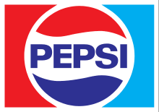
What is a trademark?
Any visible sign capable of distinguishing the goods ("trademark") or services ("service mark") of an enterprise
Circa 1969 – That famous white wave
http://www.coca-cola.co.uk/125/history-of-coca-cola-logo.html
Fair use
Circa 1969
The logo may be obtained from Pepsi Inc..
Fair use

Slide 26
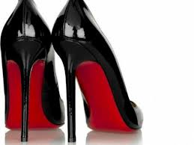
Types of trademarks
Devices or logos.
Names: Meiling
Words: Seven for all Mankind
Letters: LV
Numerals: 4711
Configurations, patterns, ornamentations, color or containers for goods
  non-visible signs (sound, smell or taste)
http://cdn.fashionbi.com/uploads/article_image/file/405/images.jpeg

Slide 27
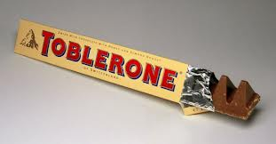
Designs & Trademarks
If a product’s design becomes a distinctive feature of that product, it can be protected as a 3D trademark (in some countries).
Once a design acquires distinctiveness through its use in the market it may qualify for trademark registration.

Slide 28
Legal Framework
International Treaty
  Paris Convention for the Protection of Industrial Property
  Trademark Law Treaty
  Singapore Treaty on the Law of Trademarks
National Legislation

Slide 29
Registration and Duration
TMA – Outlines registrable mark
  Also outlines when a mark will not be accepted for registration
Duration
  Most Caribbean countries – 10 years of protection Renewable in 10 year increments forever
Stock Image – Registration http://www.fotosearch.com/CSP390/k3903493/

Slide 30
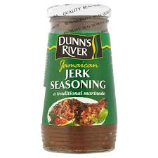
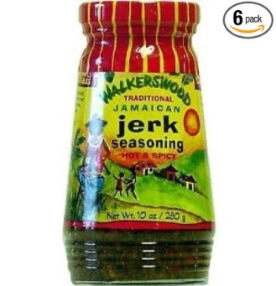
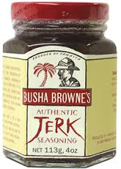
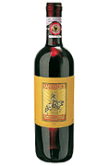
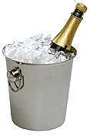
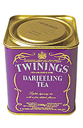
Geographical indications

Slide 31

Geographical Indications (GIs)
Is a sign used on products which signifies a specific geographical origin and therefore qualities or reputation that are due to the origin.
        http://www.wipo.int/geo_indications/en/
Appellation of Origin is a type of GI
http://www.bluemountaincoffee.com/

Slide 32
The Legal Framework
International framework:
  Lisbon Agreement for the Protection of Appellations of Origin and their International Registration
National framework
  IPA Part VI (Marks) - Chapter 7- Geographical Indications

Slide 33
Copyright

Slide 34

What is copyright?
Copyright refers to the rights granted to authors, artists and other creators in their literary or artistic “works”
Microsoft Office stock image clipart

Slide 35
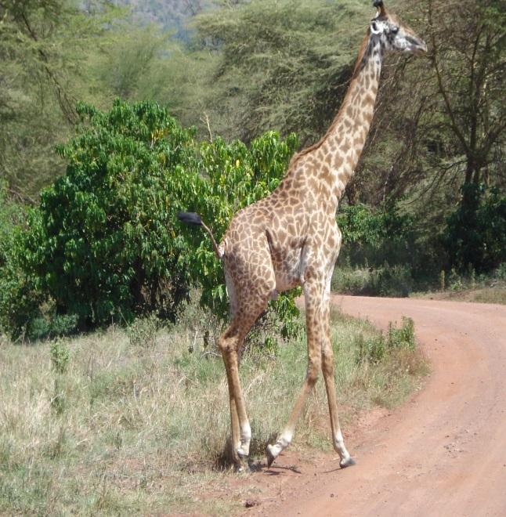
What can be protected?
Original works
  Paintings/drawings
  Books
  Lyrics
  computer programs
  Poems
  Photographs
  Paintings
The right exists the moment work is “fixed”
Work does not need to be “good” to be protected

Slide 36
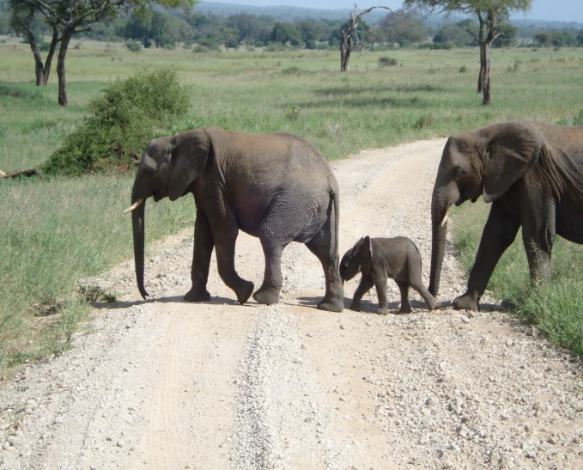
Two types of rights
Economic Rights
  Compensation for work
  Authorize or prohibit use
Moral Rights
  To object to uses of his/her work
  Right to be named as the creator

Slide 37
The Legal Framework
International Instruments:
  The Berne Convention for the Protection of Literary and Artistic Works
  Convention for the Protection of Performers, Producers of Phonograms and Broadcasting Organizations - Rome Convention
  WIPO Copyright Treaty
  WIPO Performances and Phonograms Treaty
  Beijing Treaty on Audiovisual Performances
  Marrakesh Treaty to Facilitate Access to Published Works for Persons Who Are Blind, Visually Impaired or Otherwise Print Disabled
National Legislation

Slide 38
Registration and Length of Protection
Different from other IP
No registration required
  No Formalities (Berne)
Many African countries have registration system for copyright
Duration
  Minimum Level under Berne Convention
    Life + 50 years
    Life + 70
    Life + 95
Stock Image – Registration http://www.fotosearch.com/CSP390/k3903493/

Slide 39
Who Owns What?
You own it, if
You created it.
You were commissioned to create it
Received grant (patent/trademark/industrial design)
You don’t own it, if
It was created in the course of employment and no contract stating otherwise…
You contracted your rights away (i.e., commission contract)
Transferred rights to a 3rd party
      (Text from Presentation by: Silvia Baumgart)

Slide 40
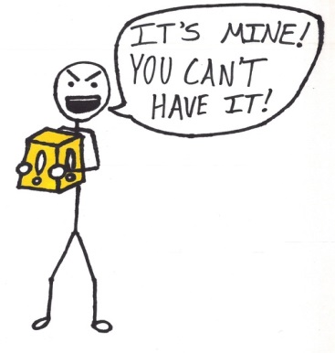
Proving It’s Yours
Keep records showing progression of your work
Mark sketches, drafts, etc., with your name and date created
Keep a record of who you shared your work with
Use confidentiality/non-disclosure agreements before sharing work with others
  (From Presentation by: Silvia Baumgart)
http://cdn-media-1.lifehack.org/wp-content/files/2014/08/mag7.jpg

Slide 41
Knowledge economy and Smes

Slide 42

The Knowledge Economy
Microsoft Office stock image clipart
                One definition: The knowledge economy is the use of knowledge to generate tangible and intangible values. https://en.wikipedia.org/wiki/Knowledge_economy
Another definition: The term “knowledge-based economy” results from a fuller recognition of the role of knowledge and technology in economic growth.
  Innovation is the thing that links the two

Slide 43

Stock image: MS PowerPoint clip art
Innovation refers to the translation of the invention/creation into a marketable product or process
http://blog.ted.com/new-documentary-at-sxsw-traces-william-kamkwambas-journey-from-rural-malawi-to-the-ted-stage/

Slide 44

Your IP/Creation -
Understand what you have
Decide if and how you will protect it?
  Using IP system – get the necessary information
    Local IP Office/Chamber of Commerce
      Reduced fees for SMEs
    Regional Organizations
      Caribbean Export Development Agency
      International Organizations
      WIPO
      ITC
      UNCTAD
Microsoft Office stock image clipart
Notes:
The regional and international organizations also provide information on market access, information on branding, marketing, non-tariff barriers, etc.

Slide 45

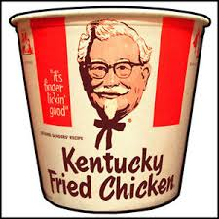
Using Trade Secret and Not IP
Microsoft Office stock image clipart
What is it: it is information that is not generally known to the public;
Could be:
  A formula, practice, process, design, instrument, pattern, commercial method, or compilation of information which is not known or reasonably ascertainable by others
Confers some sort of economic benefit on its holder ;
Is the subject of reasonable efforts to maintain secrecy
        https://en.wikipedia.org/wiki/Trade_secret

Slide 46
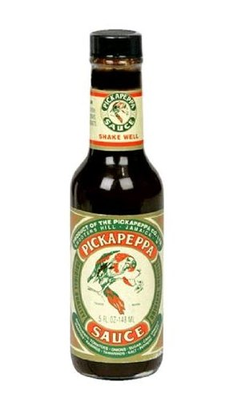

Trade secret
Could be any confidential business information which provides an enterprise a competitive edge
Used often by SMEs – inexpensive, but requires vigilance
Should:
  Be limited number of people who know the secret
  Include confidentiality agreements within employees' contracts
  Sign confidentiality agreements with business partners
http://www.nut-med.com/

Slide 47

Business Plan – Essential
Microsoft Office stock image clipart
Benchmark for developing and growing business
  Should be reviewed regularly to make sure you are on target
  Should be revised as necessary
Think about your current and potential IP when developing plan
  What do I have that could be considered IP?
  What is its value?
  Can it be protected? How will it be protected? Should it be protected? Expense, limited market, etc.
  How will be used, shared, further developed, etc.?
Notes:
As mentioned earlier, IP does should not be equated with technology. It could be something simple as a breastfeeding tee-shirt new method to cut crops or as complicate new rain water filtration system.

Slide 48

IP Not Enough – One Factor
To be competitive
  Understand your market – market research
  Plan your marketing and develop branding strategy
  Understand your access to markets
  Understand the market entry barriers (those seeking to enter international markets)
  Globalization has changed the playing field (MNs Rule)
    Need to Build networks and partnerships (country/region/globe)
        Point for market entry
        Shared Costs
        Source of potential new products or technology (Licensing potential)
Microsoft Office stock image clipart

Slide 49
IP Musts
Register your mark (logo, slogan, etc.)
  In all markets where you will operate
    WIPO Madrid System
Protect Brand and Reputation
Seychelles
United States
Germany
Trinidad and To.
Antigua & Bar.
Zimbabwe
http://www.nut-med.com/
Canada

Slide 50
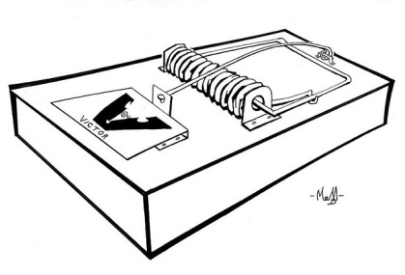
IP Musts, cont.
Where applicable, review patent documents
  Yes, difficult, but…
  Potentially good way to find new products/processes
    Licensing-in desired technology
      Modification of product/process to your market
        Creates new IP owned by you
          Licensing-out improvements
  Prevents duplications / Waste of resources
    Prevents inadvertent infringement or legal disputes
      (Apple and Samsung)

Slide 51
Questions?

Slide 52
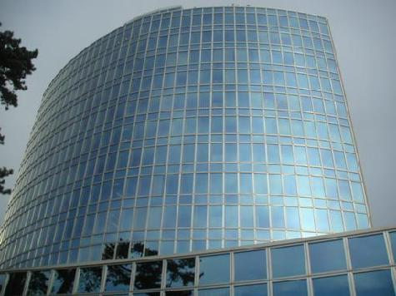
THANK YOU!!!!!!
For more information visit: www.wipo.int

