Slide 1


Geographical Indications,
Innovation and Competitiveness
Creativity, Innovation, Intellectual Property, Productivity
=
Enhanced Competitiveness, Jobs, Profits, Social Progress

Slide 2
Competitiveness: increase Innovation + Productivity
Innovation is:
Fundamental element of Competitiveness
Central driver of economic growth, development and better jobs
Enables firms to compete successful in global markets
Solves social, environmental and economic challenges
Innovation can eradicate poverty
“The UN says it should be part of the Global development Agenda”

Slide 3
Competitiveness Unit Suriname
Competitiveness Unit Suriname
I.
Business Climate Reform
II.
Industrial Policy & Innovation
III.
Law & Governance
IV.
Social Progress & Environment
1. A2F: Secured transaction Regime
2.IDA Singapore: Improve Ease of Doing Business
1. Strategic Plan for improving economic diversification & SME productivity
2. Pilot Value Chains for Innovation
1. Framework for Private Sector Development: Action Plan for Business Climate Reform & Legal Reform
2. Establish a Regulatory & Institutional Framework for improved Business Climate
1. REACH: Regional Entrepreneurial Asset Commercialization Hub
2. GEM: Global Entrepreneurship Monitor

Slide 4
Business Climate: challenges and solutions
Lack of good Business Climate
Lack of Good Governance + Transparency
Intellectual Property rights not full protected
Administrative procedures are costly and time consuming
Actions:
Administrative procedures &
Admin. Judge
E-Publication for Gov’t
Difficulties to get finance
Movable property can’t be used solely as collateral
Actions:
Secured Transactions Law &Secured Trans. Register
Intellectual property rights outdated
Actions:
Industrial Property Rights laws + strengthen Institutional capacity
Business Facilitation deficiencies
Lack of a competition framework
Actions:
Competition Law &
Consumer Protection law
Financial Statement Law
Permits are costly and time consuming
Actions:
Businesses and Professions Law
Trade Register La+ Self-Employed Persons
E- Transactions Law
Access to justice is time consuming
Actions:
ADRs Framework + Mediation

Slide 5
Intellectuele Eigendom
Industrieёle Eigendom
Octrooien / Patent
Tekeningen + Gebruiksmodellen
Auteursrecht + Naburige Rechten
Handelsnamen
Geografische Indicaties
Databank + Chips
Merken
Kwekersrecht

Slide 6
Pillar 12 GCI: Innovation historical overview
Pillar 12 | Innovation | 2012/2013 | 2011/2012 | 2010/2011 | 2009/2010 | 2008/2009
12.01 | Capacity for innovation | 106 | 100 | N/A | 98 | 104
12.02 | Quality of scientific research institutions | 128 | 120 | N/A | 116 | 111
12.03 | Company spending on R&D | 115 | 116 | N/A | 102 | 89
12.04 | University-Industry collaboration in R&D | 106 | 117 | N/A | 106 | 97
12.05 | Gov’t procurement of advanced tech products | 126 | 120 | N/A | 123 | 128
12.06 | Availability of scientist and engineers | 111 | 103 | N/A | 111 | 118
12.07 | PCT patents, applications/millions pop* | 92 | 90 | N/A | 90 | 88

Slide 7
Actions for Innovation:
Improve the Innovation Environment:
Create Legal Framework for Innovation to promote & protect IP
Create Innovation Network: science/business/gov’t
STEM Education & Vocational and skills training
Incentives for innovation: Financial, non-financial
Promote Science & Technology
Promote Business – University collaboration
Increase Business spending on innovation

Slide 8
Legal Framework for improved Investment Climate: the core minimum based on a 4 Axes Strategy
Good Governance and Transparency
Administrative procedures and Administrative Judge
Electronic Publications
Promoting Innovation & Intelectual Property
Access to Justice & Contract Enforcement
Alternative Dispute Resolution/ ADR
Center for ADRs
Business Facilitation and A2F
Competition law
Business and Professions
Trade register with Self employed
Secured Transactions Act: A2F
Simplified Corporations LAV
E-transactions Act
Consumer protection law
Financial Statements Act
Copy rights & Related rights
Traditional Knowledge
Industrial Property Rights

Slide 9
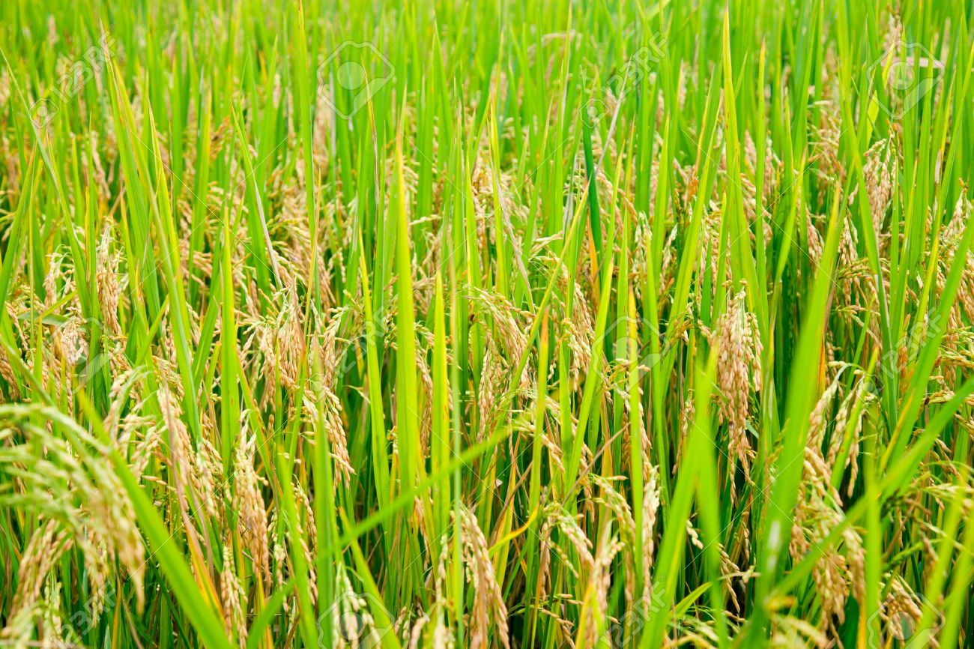
(not) MADE IN SURINAME
Pictures of (Suriname) Long grain rice Sold in the Netherlands

Slide 10
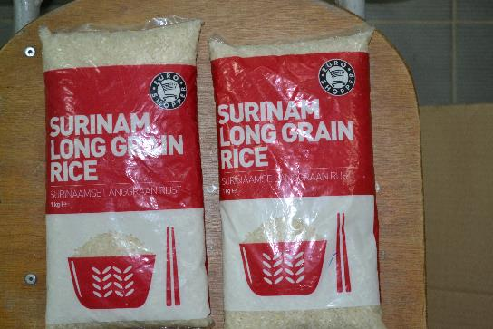
Euroshopper

Slide 11
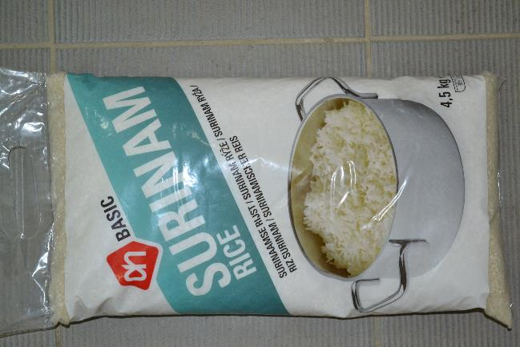
Albert Heijn

Slide 12
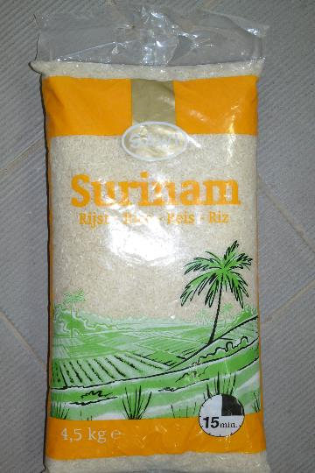
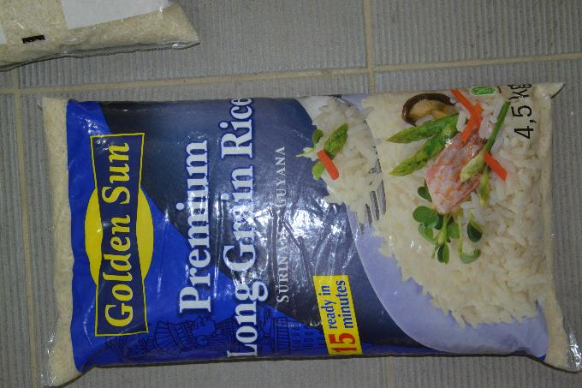
Suriname
Goldenstate

Slide 13
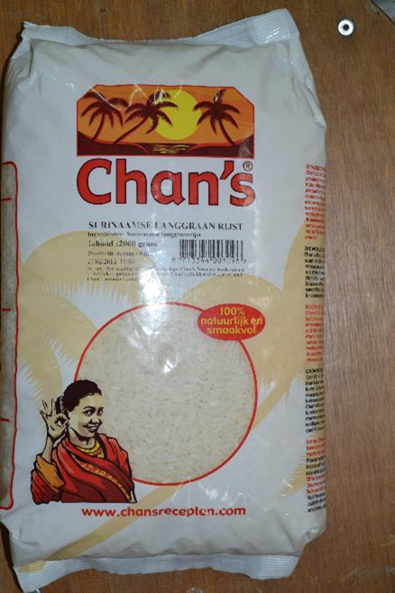
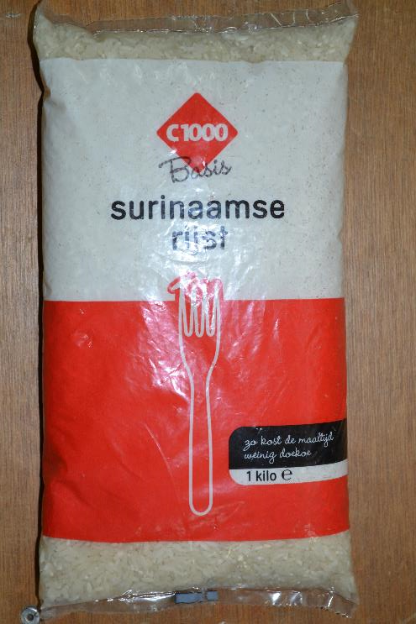
C 1000
Chan’s

Slide 14


