Slide 1
Education and Innovation

Slide 2
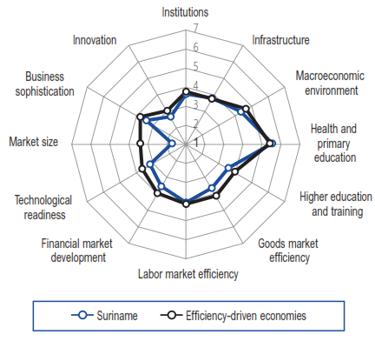
Business Efficiency Drivers

Slide 3
Global competitiveness Index
5th pillar higher education and training
Secondary education enrollment
Tertiary education enrollment
Quality of the educational system
Quality of math and science in education
Quality of management schools
Internet access in schools
Availability of research and training services
Extent of staff training

Slide 4
Global competitiveness Index
12th pillar of innovation
Capacity for innovation
Quality of scientific research institution
Company spending of R&D
University-Industry collaboration in R&D
Gov’t procurement of advanced tech products
Availability of scientist and engineers
Pct. patents, applications

Slide 5
Goals:
Allignment of education and innovation with the priority sectors
Bringing employers and schools together

Slide 6
Suriname Compete !!!! Join the Beat !!!

