Slide 1
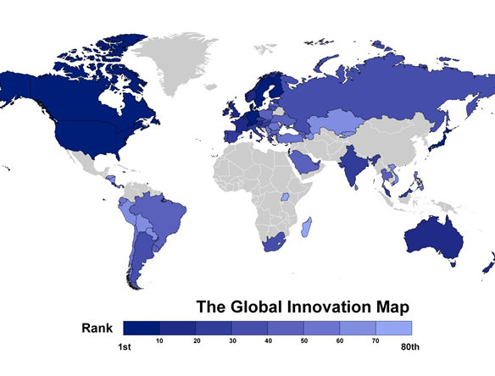

INNOVATION - INNOVÂTIAÔ
STI and Competitiveness for Welfare and Prosperity for all

Slide 2
Tasks of CUS
Coordinate Government actions to strengthen National Competitiveness
Identify priority economic growth sectors
Develop a Private Sector Development Roadmap
Develop/ Monitor Doing Bussiness Agenda
Develop/ Monitor National Competitiveness Strategy and Action Plan

Slide 3
Definitions of Competitiveness
1.Productivity with which countries use their Human, Financial en Natural Resources; Porter
2. Set of Institutes, Policies and Factors that determine the level of Productivity; WEF
3. Create/ maintain an environment that guarantees value addition for businesses + welfare for the population ; IMD

Slide 4
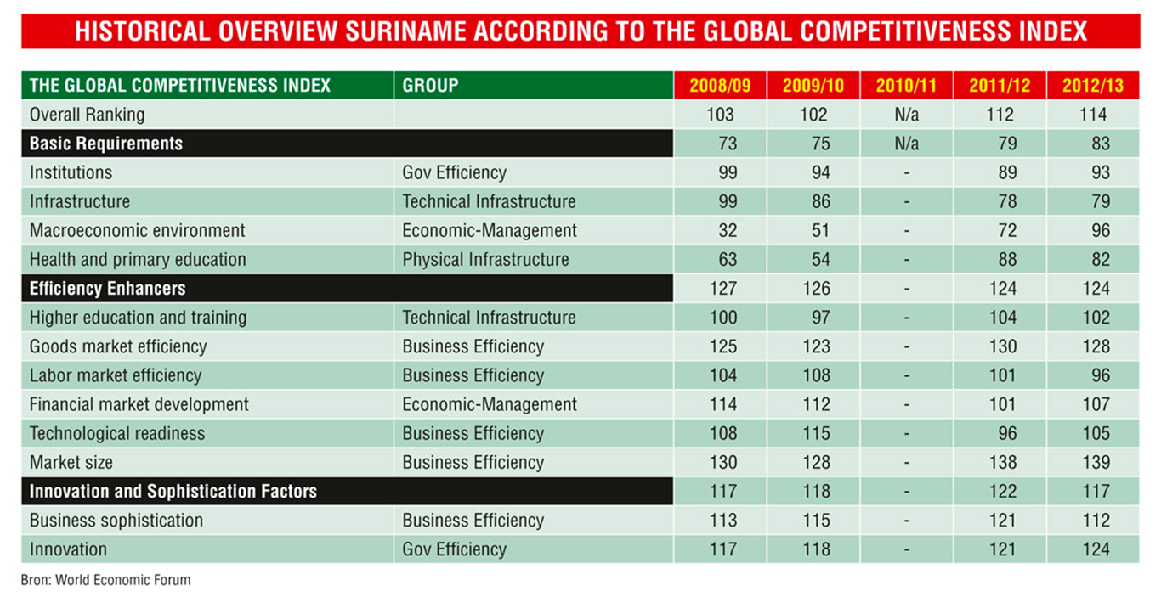
Historical overview

Slide 5
Historical overview: innovation pillar according to the Global Competitiveness Index
12th Pillar | Innovation | 2012/2013 | 2011/2012 | 2010/2011 | 2009/2010 | 2008/2009
12.01 | Capacity for innovation | 106 | 100 | N/A | 98 | 104
12.02 | Quality of scientific research institutions | 128 | 120 | N/A | 116 | 111
12.03 | Company spending on R&D | 115 | 116 | N/A | 102 | 89
12.04 | University-Industry collaboration in R&D | 106 | 117 | N/A | 106 | 97
12.05 | Gov’t procurement of advanced tech products | 126 | 120 | N/A | 123 | 128
12.06 | Availability of scientist and engineers | 111 | 103 | N/A | 111 | 118
12.07 | PCT patents, applications/millions pop* | 92 | 90 | N/A | 90 | 88

Slide 6
Historical overview: Business Sophistication pillar 11 Global Competitiveness Index
11th Pillar | Business sophistication | 2012/2013 | 2011/2012 | 2010/2011 | 2009/2010 | 2008/2009
11.01 | Local supplier quantity | 116 | 110 | N/A | 115 | 119
11.02 | Local supplier quality | 98 | 99 | N/A | 108 | 96
11.03 | State of cluster development | 122 | 138 | N/A | 102 | 118
11.04 | Nature of competitive advantage | 112 | 106 | N/A | 128 | 112
11.05 | Value chain breadth | 108 | 117 | N/A | 127 | 127
11.06 | Control of international distribution | 118 | 124 | N/A | 88 | 80
11.07 | Production process sophistication | 109 | 112 | N/A | 97 | 96
11.08 | Extent of marketing | 117 | 120 | N/A | 111 | 108
11.09 | Willingness to delegate authority | 111 | 125 | N/A | 109 | 105

Slide 7
Historical overview: Technological readiness pillar 9 Global Competitiveness Index
9th Pillar | Technological readiness | 2012/2013 | 2011/2012 | 2010/2011 | 2009/2010 | 2008/2009
9.01 | Availability of latest technologies | 110 | 101 | N/A | 120 | 121
9.02 | Firm-level technology absorption | 121 | 124 | N/A | 117 | 122
9.03 | FDI and technology transfer | 130 | 131 | N/A | 132 | 134
9.04 | Internet users | 83 | 78 | N/A | 122 | 113
9.05 | Broadband Internet subscriptions | 76 | 83 | N/A | 88 | 61
9.06 | Internet bandwidth | 109 | 91 | N/A | 94 | 91
9.07 | Mobile broadband subscription | 128 | N/A | N/A | 88 | 80
9.08 | Personal computers | N/A | N/A | N/A | 87 | 88

Slide 8
WHAT IS INNOVATION?
Process of translating an idea or invention into a good or service that creates value or for which customers will pay
Elements of innovation:
Replicable at an economical cost
Satisfy a specific need
Deliberate application of information, imagination and initiative to derive greater/ different values form resources
Includes all process to generate new ideas and convert them into useful products
First use of term Innovation: 15th century

Slide 9
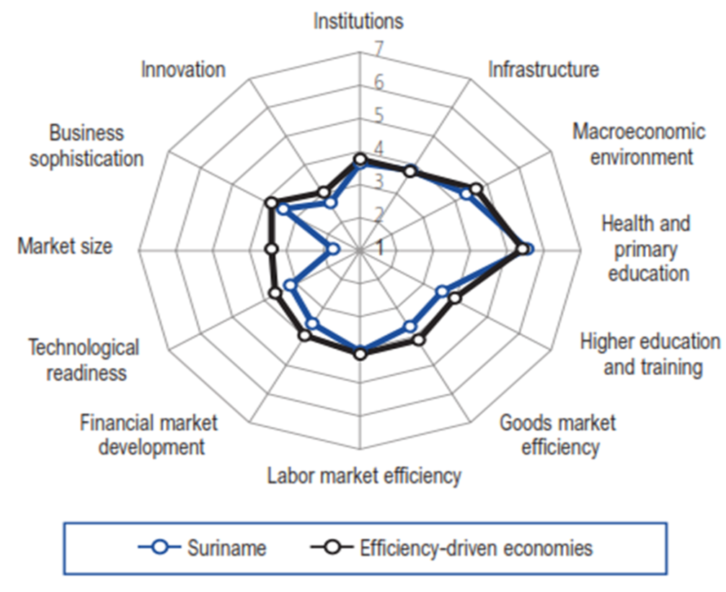
GOAL: an Innovation Driven Economy

Slide 10
Improve our Competitiveness:
Prioritize attractive economic key sectors
Integrated Industrial Policy
Applied research: value adding in non-traditional sectors + alternative use of natural resources
Improve level of Innovation
Align Education with economic sectors
(e.g. Gold, Oil, Energy, Agriculture, Forestry)
Institutional capacity + legislative framework for business growth
Population Growth Policy: Market Size

Slide 11
Competitiveness = raise
Innovation and Productivity
Innovation is:
Fundamental element of Competitiveness
the UN says it should be part of the Global development Agenda:
Central driver of economic growth, development and better jobs
Enables firms to compete successful in global markets
Solves social, environmental and economic challenges
Innovation can eradicate poverty

Slide 12
CUS Actions for Innovation:
Improve the Innovation Environment :
Create Innovation Network: science/business/gov’t
Labor market Study with Innovation survey
STEM Education & Vocational and skills training
Create Legal Framework for Innovation: promotion & protection: IP Law
Incentives for innovation: Financial, non-financial
Promote Science & Technology

Slide 13
Government challenges: more growth, productivity & jobs
WHAT: Raise Competitiveness and Economic Prosperity:
Increase productivity
Promote Private Sector Development
Strengthen national innovative capacity
HOW: Create National Innovation Framework
Improve R&D: tertiary education, centers of excellence
Create Centers of Knowledge: networks for knowledge sharing and science-business collaboration;
FDI technology transfer
Protect innovations, inventions and creative goods: IPL
Decentralize innovation and development: Inclusion

Slide 14
SME Actions for Innovation:
Improve Science and Technology use
Improve capacity for innovation
Cluster & Cooperate
Form PPPs for training and innovation
Raise company spending on innovation
Raise business-science collaboration
But also:
Think social: Social Innovation
Think out of the Box: Reverse Innovation

Slide 15
Structure of CUS
Proposed: sub-Council
Ministers for Economic Development
Suriname Business Forum
Competitiveness
Unit Suriname
I.
Business Climate Reform
II.
Innovation
& Industrial Policy
III.
Institutions, Law & Governance
IV.
Human Capital Development
Secretariat
Monitoring & Reporting

Slide 16
Alan Kay, Computer scientist
"The best way to predict the future is to invent it”

Slide 17
Thank you
Suriname Competes!
Kondreman the Beat !

