Slide 1


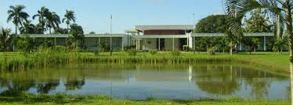
Technological Innovation for growth.. An Agricultural point of view
Dr. Inez Demon
12-03-2015

Slide 2
Technological Innovation for growth..
Even this Concept has an inescapable foundation: agriculture…
The extent to which we can exploit digital technologies is determined by whether or not we can produce enough food—efficiently and sustainably—to support ourselves.
This is one of the most important factors that determines the fate of our economies and societies.

Slide 3
World population development
Total demand is expected to rise 70 percent by 2050, and current growth rates in agriculture are not sufficient to meet this goal.

Slide 4
“Over the next 40 years, land, energy, water, and weather constraints will place unprecedented pressure on mankind’s ability to access its most basic goods—food, fuel, and fiber. Humanity must now produce more food in the next four decades than we have in the last 8,000 years of agriculture combined. And we must do so sustainably.” (The 2050 Criteria,” World Wildlife Fund)

Slide 5
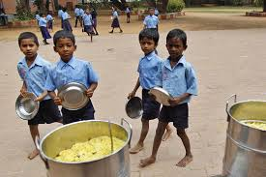
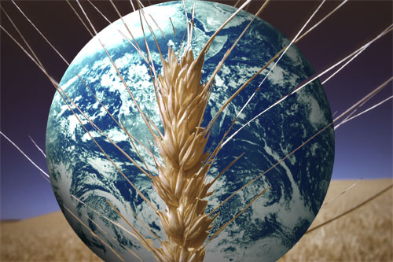
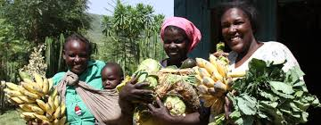
FOOD SECURITY & FOOD INDEPENDENCE
“Food security” is defined as” everyone always having physical and economic access to buy produce, obtain or consume sufficient, safe and nutritious food to meet their dietary needs and food preferences for a healthy and active life” (International Federation)
Suriname’s view:
Through own production, preferably in partnership, lifting the
country’s position up to the level which satisfactorily fulfils the
requirements set for “Food security” (given some geographic benefits and available natural resources)

Slide 6
Agriculture Technological (AgTech) innovations are absolutely essential to meet this goal…
We need to explore the pressures facing the global agriculture system and identify the enormous opportunity for innovation, and associated investment, in what could be a large (growing) economic sector.

Slide 7
Opportunities for growth
In general there is limited opportunity to expand the land used in agricultural production, and agriculture also must deal with environmental risks such as climate change.
To succeed in sustainably increasing food production, major innovations in AgTech are required that increase agricultural productivity and improve the efficiency and resiliency of the entire food system.

Slide 8
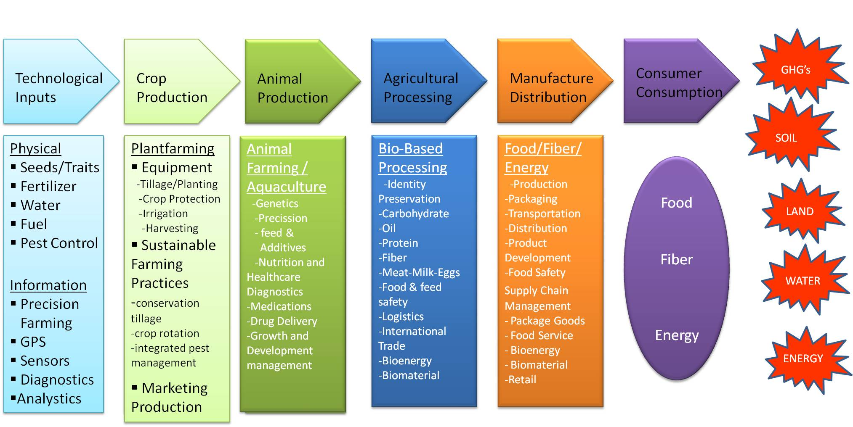
The AgTech value chain
Source: Duttia et al 2014

Slide 9
Innovation along the value chain
Information Technology Inputs:
e.g. irrigation systems: moisture sensors and smart information technology
Physical Technology Inputs: use of genomics /plantbreeding to identify compounds/proteins/genes/crop species to control diseases & pests
Plant production: development of novel robotics/materials/ handling systems for agriculture and greenhouse applications

Slide 10
Many opportunities for investment Exist & innovation is needed throughout the entire value chain.
Animal Nutrition & Health
Aquaculture
Biomaterials
Bionutrition
Biotechnology
Crop Nutrition/ Crop Protection
Decision Support Technologies
Feed Efficiency
Fertilizer Efficiency
Food Traceability and Safety
Food Storage and Preservation
Information Systems
Integrated Pest Management
Bioenergy
Biological Pest Control
Land Management
Machinery
Precision Agriculture
Robotics
Seeds and Genetics
Soil Amendments / Health
Sustainable Production Systems
Technology Transfer
Urban Agriculture
Water Quality and Preservation
Waste Mitigation and Manure Management
Irrigation Efficiency

Slide 11
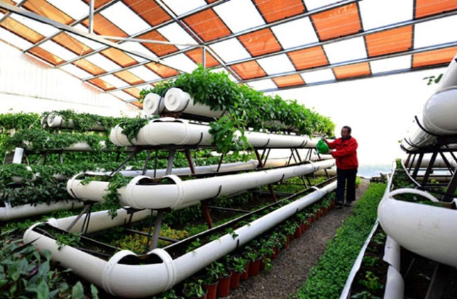
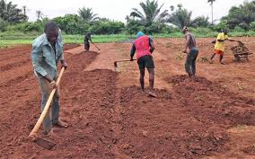
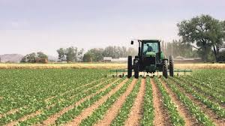
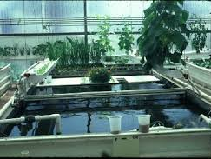
Entrepreneurs are problem solvers, and twenty-first century agriculture has no shortage of problems that, looked at another way, are opportunities for innovation.

