Slide 1
Global Competitiveness Report
2013/14
Suriname

Slide 2

The Global Competitive Report
The GCR is produced by the World Economic Forum
The report is based on the Global Competitiveness Index (GCI)
The GCI captures information on the micro and macro economic foundations of national competitiveness.

Slide 3
The Global Competitive Report
The report examines the many factors that enable national economies to achieve sustained economic growth and long term prosperity.
The overall goal is to provide business leaders and policymakers with benchmark tools to identify obstacles to improved competitiveness.
The idea is to stimulate discussion on strategies to improve them.

Slide 4
What is Competitiveness
Competitiveness is the set of institutions, policies, and factors that determine the level of productivity of a country.
National Productivity
Institutions
Policies
Factors

Slide 5
Effect of Productivity
Productivity
Higher Income
Productivity helps drive high levels of income and determines the growth potential of an economy

Slide 6
Implied Framework
National
Competitiveness
Firm Competitiveness
Enabling Environment
Firms compete not nations.
Government largely responsible for the raw conditions

Slide 7
Sources of Data
For the report information is obtained through a very comprehensive questionnaire survey that is completed by business executives in the country.
Hard data – country statistics taken from internationally recognized sources, e.g. World Bank, IMF and WHO

Slide 8
The Results
Ranking is out of total participants
Additional to the overall ranking, countries also receives a score from 1 – 7.
This score is the weighted average score from the 12 pillars of competitiveness.
Problematic factors for doing business

Slide 9
The 12 Pillars
The many components of the competitiveness survey are grouped in various categories to form the 12 pillars of competitiveness.
Pillars are not independent - e.g. innovation tied to education
Each of the pillars consists of a number of different dimensions
There are a total of 121 dimensions
These dimensions are either considered to be a competitive advantage or a competitive disadvantage.

Slide 10
The 12 Pillars
Basic Requirements
Institutions
Infrastructure
Macroeconomic stability
Health and Primary Education
Key for
Factor-driven
economies
Efficiency Enhancers
Higher Education
Goods Market efficiency
Labour Market Efficiency
Financial Market sophistication
Technological readiness
Market size
Key for
Efficiency-driven
economies
Innovation & Sophistication
Factors
Business sophistication
Innovation
Key for
Innovation-driven
economies

Slide 11
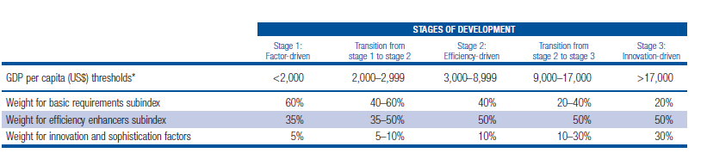
Sub Index Weighting and Income
Threshold for Stages of Development
Notes:
Suriname is classified as an efficiency driven economy with a per capita GDP of US$8,686. They are therefore at the upper end of the scale.

Slide 12
GCI 2013 – 2014
Results

Slide 13
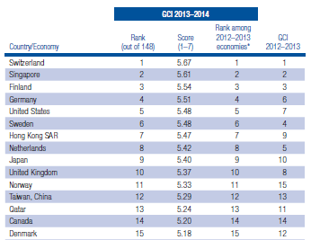

Slide 14
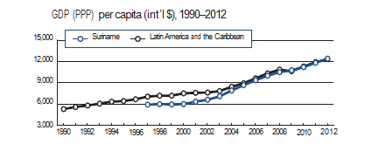
Suriname
Classified as an Efficiency Driven Economy – Stage 2
Per Capita Income - $US8,686

Slide 15
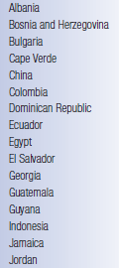
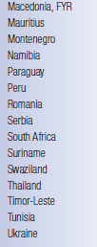
Efficiency Driven Economies

Slide 16

Suriname Ranking
An Improvement of 8 places
106
(2013)
114
(2012)

Slide 17
 | GCR 2013-2014 |  | GCR 2012-2013
 | Stage 2 Efficiency Driven |  | Stage 2 Efficiency Driven
 | Weight | Score (1-7) | Weight | Score (1-7)
Global Competitiveness Index |  | 3.8 |  | 3.7
Basic Requirements | 40% | 4.4 | 40% | 4.3
Efficiency Enhancers | 50% | 3.3 | 50% | 3.3
Innovation and sophistication factors | 10% | 3.1 | 10% | 3.0

Slide 18
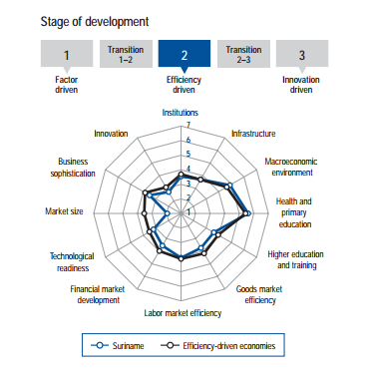

Slide 19
Strong and Weak Pillars
Strong
Weak
Health and Primary Education (5.6/7)
Macroeconomic Environment (4.9/7)
Labour Market Efficiency (4.0/7)
Infrastructure (3.7/7)
Market Size (1.9/7)
Innovation (2.7/7)
Technological Readiness (3.2/7)
Business Sophistication (3.5/7)
Institutions (3.5/7)
Notes:
Market size is heavily influenced by domestic market size which we cannot do much about.

Slide 20
Perspective of Investment
Notably competitive advantages for Suriname:
Judicial independence
Business costs of terrorism
Reliability of police services
Quality of port infrastructure
General government debt
Effect of taxation on incentives to invest
Prevalence of trade barriers
Soundness of banks
The effects of taxation on incentives to invest
Export as a percentage of GDP

Slide 21
On the Downside
Significant areas of weaknesses:
  Strength of investor protection
  Burden of Customs Procedures
  Effectiveness of anti-monopoly policy
  Market size
  Value Chain
  Willingness to delegate authority
  Capacity to innovate
  Quality of scientific research institutions
  Company spending on R & D
  Government procurement of advance tech product

Slide 22
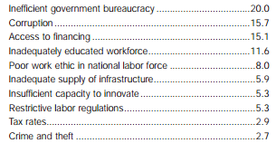
Problematic Factors for Doing Business

Slide 23
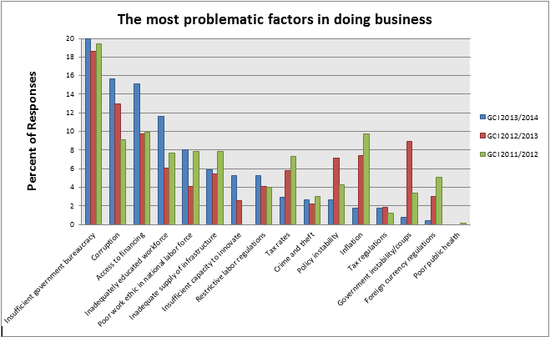

Slide 24
Caribbean Connection
Country | Stage of Dev. | Rank | Score | Problematic Factors
Barbados | 2-3 | 47 | 4.4 | Access to Finance Inefficient Gov’t Bureaucracy Poor work ethic in national Labour Force
T & T | 3 | 92 | 3.9 | Crime and Theft Inefficient Gov’t Bureaucracy Corruption
Jamaica | 2 | 94 | 3.9 | Inefficient Gov’t Bureaucracy Crime and Theft Corruption
Guyana | 2 | 102 | 3.8 | Corruption Tax Rates Inefficient Gov’t Bureaucracy
Suriname | 2 | 106 | 3.8 | Inefficient Gov’t Bureaucracy Corruption Access to Finance

Slide 25
Points to Note
Productivity – the key to improving competitiveness and this is a national issue not a government issue.
Insufficient capacity to innovate and Business Sophistication
Hard data update to international bodies – need to ensure that this is done.
Inefficient government and corruption – a problem in the Caribbean.

Slide 26
Impact of GCI in T&T
Spurred government to take steps to reduce the days to start a business from 43 days to 3 days
The Minister of Finance in his recent budget presentation set a goal to be in the top 30 in 5 years
The question of innovation is now seen as an area for improvement.
Influence government policies regarding education – e.g. GATE
Council for Competitiveness and Innovation and Caribbean Centre for Competitiveness

Slide 27
Summary
Suriname classified as an efficiency driven economy.
Ranking improved by 8 places to 106/148
Small change in overall score (3.7 to 3.8)
We still have a long way to go especially in terms of technology readiness, innovation and business sophistication
Government bureaucracy and corruption remains a major issue.

Slide 28
Thank You

