Slide 1

Registries as a catalyst towards
Competitive Markets
Competitiveness Forum Suriname, March 11 and 12, 2015
By Niko Kluyver, MBA, CPA
Representative Caribbean Region,
Latin American Chapter of the
International Factors Group (IFG)

Slide 2
Who is IFG?
“IFG”, THE INTERNATIONAL FACTORS GROUP, IS THE GLOBAL TRADE ASSOCIATION THAT FULLY REPRESENTS AND PROMOTES THE INTERESTS OF TRADE FINANCE, FACTORING, INVOICE FINANCE AND ASSET BASED LENDING INDUSTRY ON A GLOBAL BASIS.
We bring like-minded organizations together to network, educate and influence, all with a common goal of building the reach and impact of industry in the support of economies, growth and employment.
Headquartered in Brussels

Slide 3
CONNECT - EDUCATE - INFLUENCE
CONNECT
  We connect service providers with members and align with like-minded organizations to facilitate broader industry reach.
EDUCATE
  We inform, educate and support the industry in order to set standards and best practice.
INFLUENCE
  We lobby on behalf of the industry – we promote and defend the industry working closely with regulators and governments worldwide.

Slide 4
Enhancing Competitiveness
National / International
Ease of doing Business Index of World Bank
Depth of Credit Information Index (1-8)
Transparency
Enablement of SME’s and MSME’s
Comparative data
Access to finance / multiple finance providers in the market
INVESTMENT IN INFRASTRUCTURE TO ENHANCE COMPETITIVENESS
Notes:
Depth of credit information index by world bank / ease of doing business index 1=Singapore / 189 (suriname 161) is Chad http://en.wikipedia.org/wiki/Ease_of_doing_business_index
Depth of Credit Information index Suriname = Zero Transparancy Int CPI 100/175 corrpotion percention index

Slide 5
Types of Registries
Credit Information Registry
Collateral Registry - Movable Property vs Real Property
Company Registry
Not-Sufficient-Fund (NSF) Check Registry (bounced checks)
Insurance Registry
Employment Screening Registry
PEP Registry

Slide 6
General Requirements
Compliance with local laws and international best practices
Must be Online!
Transparency towards Data Subjects
Platform oriented, not decision making institutions
Flexible, modern technologies
Reliable security and back-up / recovery
Protection of Personal Data (e.g. advanced data encryption)
Independence but S.P.E.C.S governance (Security, Privacy, Environment, Compliance, Service)
Data Service Interfaces for submitting and retrieving data
System & Procedures, Independent audits: ISAE3000 series (SAS70)/SOC1,2,3 or ISO27001
Affordable and Easy to Use
Data retention policies

Slide 7
Focus 1: Credit Registry
- General -
Overall Objective: Enhance access to finance to improve economic development and create jobs
(SME’s and MSME’s typically benefit the most)
Specific Objective: collect/share data responsibly to improve credit approvals, enhance risk mitigation and prevent over-extension of credit
Behavioral (default) information and total exposure information
Legal entities: typically not governed by privacy laws, but general rights
Consumers: Privacy considerations very important. Privacy laws are the basis of consumer credit bureau operations
Informed Consent principles
Data owner vs Data Processor considerations

Slide 8
Focus 1: Credit Registry
-Best Practices-
Clearly stated objectives and comprehensive general rules
Purpose limitation (can only collect / access data for intended purposes)
Reciprocity (those who have no data to share, typically have no reason to see)
Comprehensive: Positive, Negative and data from FI’s, NFI’s & Courts
Code of Conduct (in some countries also credit bureau legislation)
Disputes Committee / Arbitration (rights of data subjects)
Efficient independent facilitator, no decision-making role
Organized introduction and training to avoid misinterpretations
Independence in operation / Independent audits for assurance
Local stakeholder platform, membership international industry association

Slide 9
Focus 2: Collateral Registry
-General-
Overall Objective: Enhance access to finance to improve economic development and create jobs (Same overall objective!)
Specific Objectives: promote funding on the value of movable assets by registering security interests to provide public priority
(especially beneficial to SME’s and MSME’s)
1. notify lenders and other interested parties about the existence of a
security interest in movable property
2. establish the priority of creditors over a security interest vis-á-vis
third parties (third party effectiveness)
Must be accompanied by related insolvency laws to protect the rights of the holders of the secured lender
Law on Secured Transactions or Personal Property Security: include chapter or section on the collateral registry

Slide 10
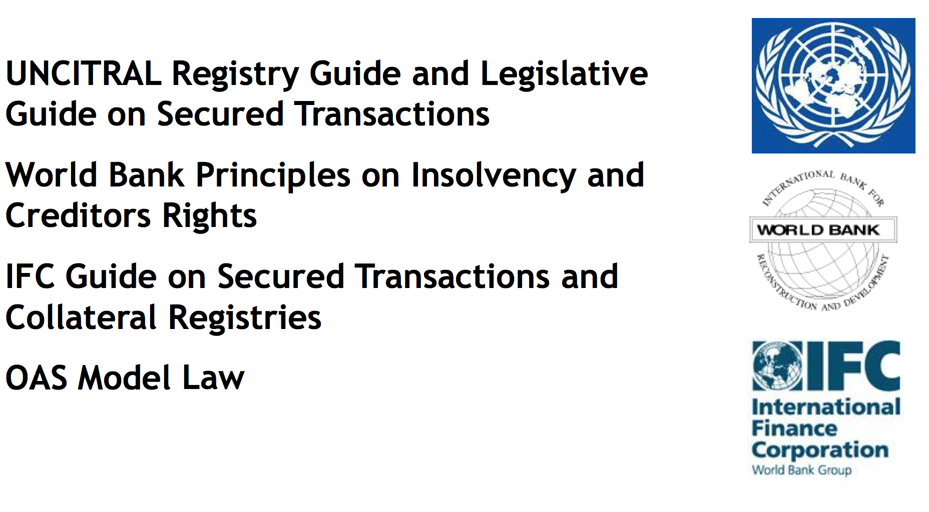

Focus 2: Collateral Registry
- Internationally Accepted Standards -

Slide 11
Focus 2: Collateral Registry
- Best Practices -
Regulations to implement the registry: general rules on the operation of the registry
One Centralized Register (where sensible cross jurisdictional searches)
Notice based: registration by secured creditors (limited role of the registrar)
Online ! , accessible to everyone - searches at no charge!
Consider limitation of details on public searches to necessities (Use RAC’s to protect privacy & security and mitigate unintended reverse searches)
Register all movable assets: e.g. term loans, accounts receivable (ex: factoring), financial leases, retention of title, trusts, patents, (vehicles?)
Allow for different centricity on searches: Public: Debtor, Asset (collateral) and Private: Creditor centric search access for creditor’s own review.

Slide 12
Credit and Collateral Registry
-Technology-
Build, buy, lease ? (Pro’s / Con’s)
Outsource application / with or without operations (Pro’s / Con’s)
Login Access Security / Data Control / Data Protection
Robust Processing Core / Flexible logic overlay & modern intuitive GUI
Advanced in and outgoing interfaces
Data capture technology (to support readiness of members with legacy technology)
Unparsed data decoders for fields with unparsed data
Smart search logic and data-subject record coupling logic
Interfaces with relevant jurisdictions
Use of Report Access Codes (RAC’s) issued to Data Subjects to protect privacy
Cloud vs Local Server (Cloud + Local store?)
Automated correspondence (email / text)

Slide 13
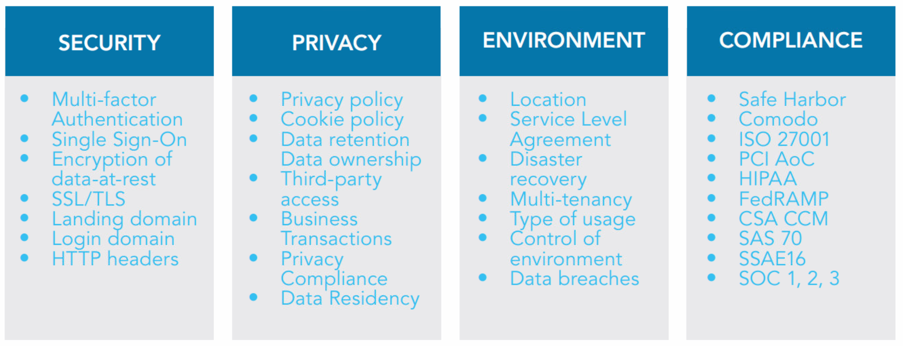
S.P.E.C.S. Governance
*
+ SERVICE!
* From: Cloud Adoption & Risk Report for North America & Europe: 2014 Trends, by CipherCloud, 2015

Slide 14








Niko Kluyver
niko@corporatefinancialsolutions.com
Tel: +599 9 5125166
+1 (305) 921 0392

