Slide 1

Fab Lab Paramaribo putting innovative tools in the hands of (potential) entrepreneurs in Suriname Reina Raveles reinaraveles@yahoo.com
MAKE IT IN SRANAN

Slide 2
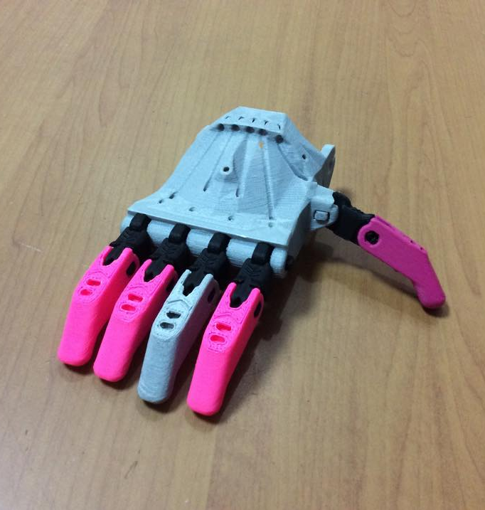
How to make almost anything
Fab Labs started in MIT Center of Bits and Atoms
Now more than 450 labs in 67 countries
ICT to create
In Suriname: Fab Lab Paramaribo set up by the Cabinet of the Vice President
Open since may 2013

Slide 3
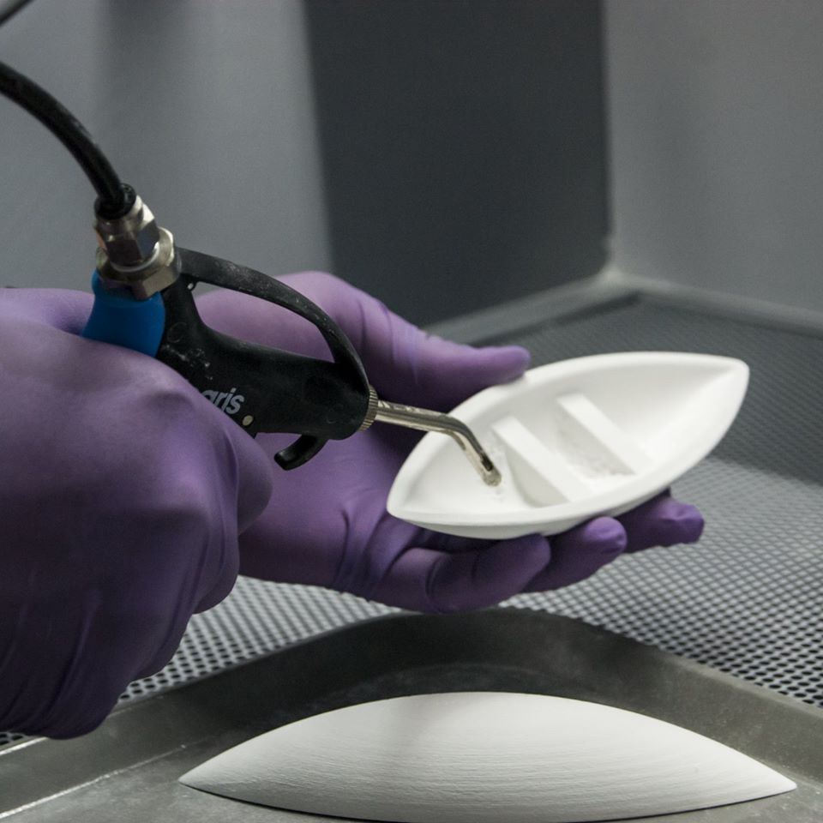
So what is the key message?
If you can think it
you can draw it
you can design it
you can make it
And we are here to help

Slide 4
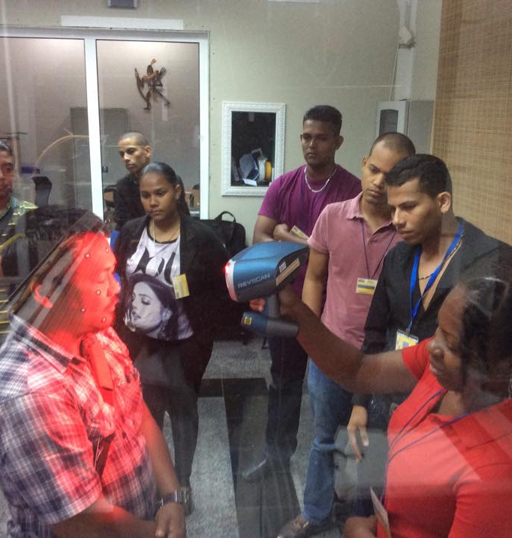
How do we help?
Computer aided machines and tools
Design Software
Internet & Open source
Outreach and awareness
Presentations
Workshops and Training

Slide 5
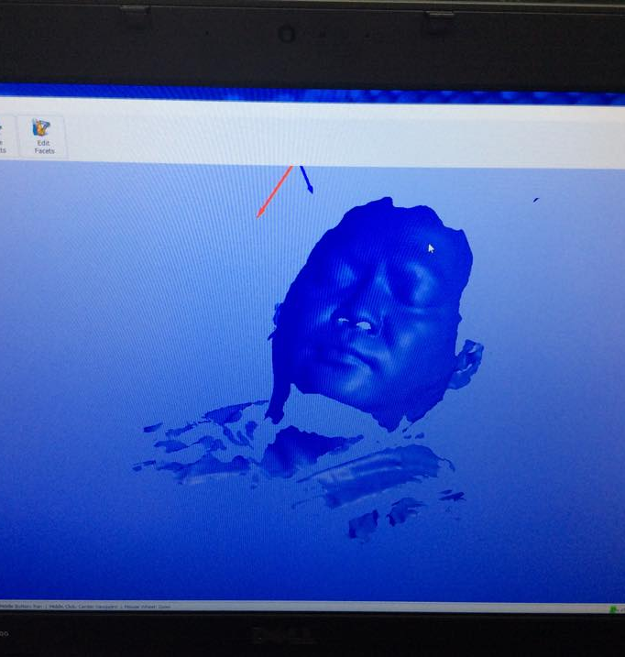
How do we help?
Brainstorming, Idea sharing
Documentation center
Technical Support
Socializing and networking
Internships and research

Slide 6
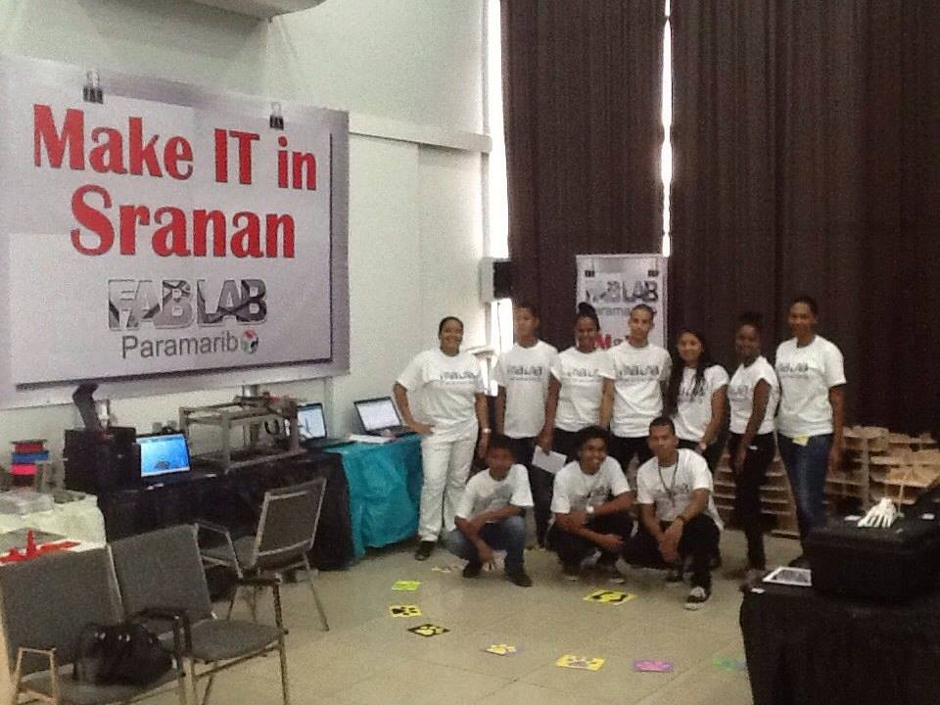
Main outreach channels
Facebook
Demo’s at fairs
Key partnerships

Slide 7
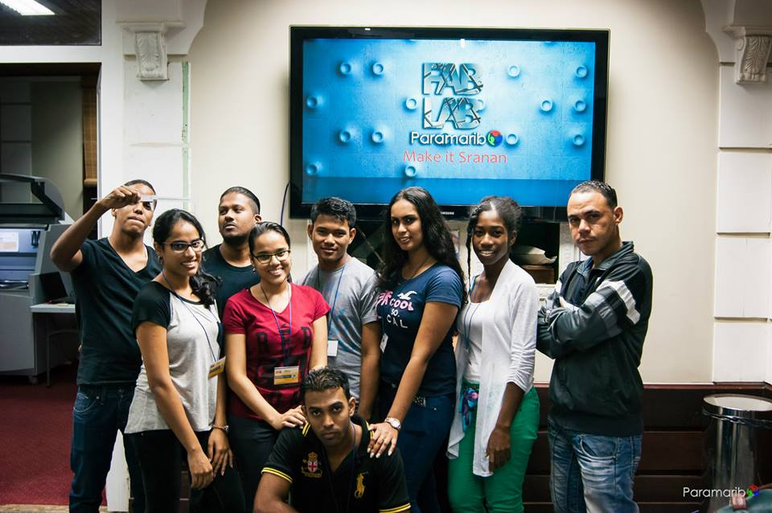
People who come to us:
Students, Teachers, Small entrepreneurs, Starters, Tech savvy, artists, designers
Are driven by:
Curiosity
Business ideas (Product or solution for an issue)
Creative ideas
To learn
School project
Something creative for a loved one, family, friend, colleague, the home

Slide 8
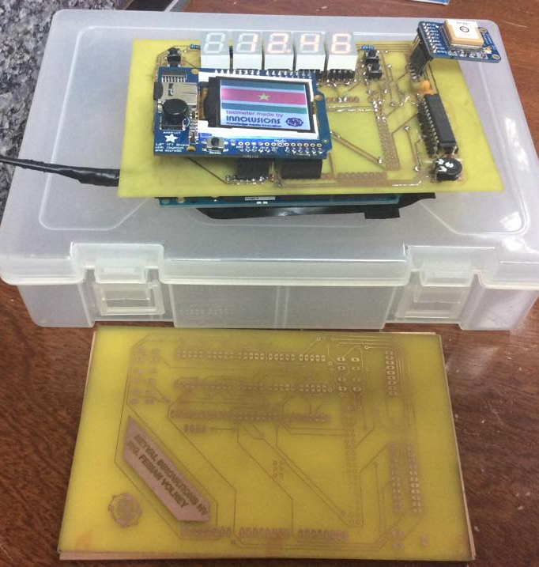
You’d be surprised about the capacity, creativity and hidden talents in this place
And we (the country) let it go to waste all this time ☹

Slide 9
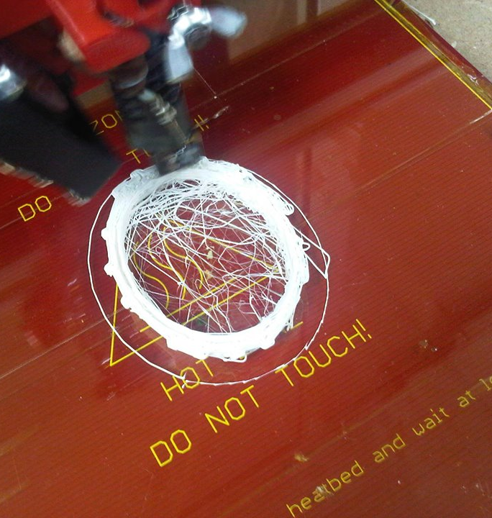
Challenges
Machine maintenance and downtime
Personnel need
Gov’t financial and decision making processes (oi!)

Slide 10
So how do we go from here….

Slide 11
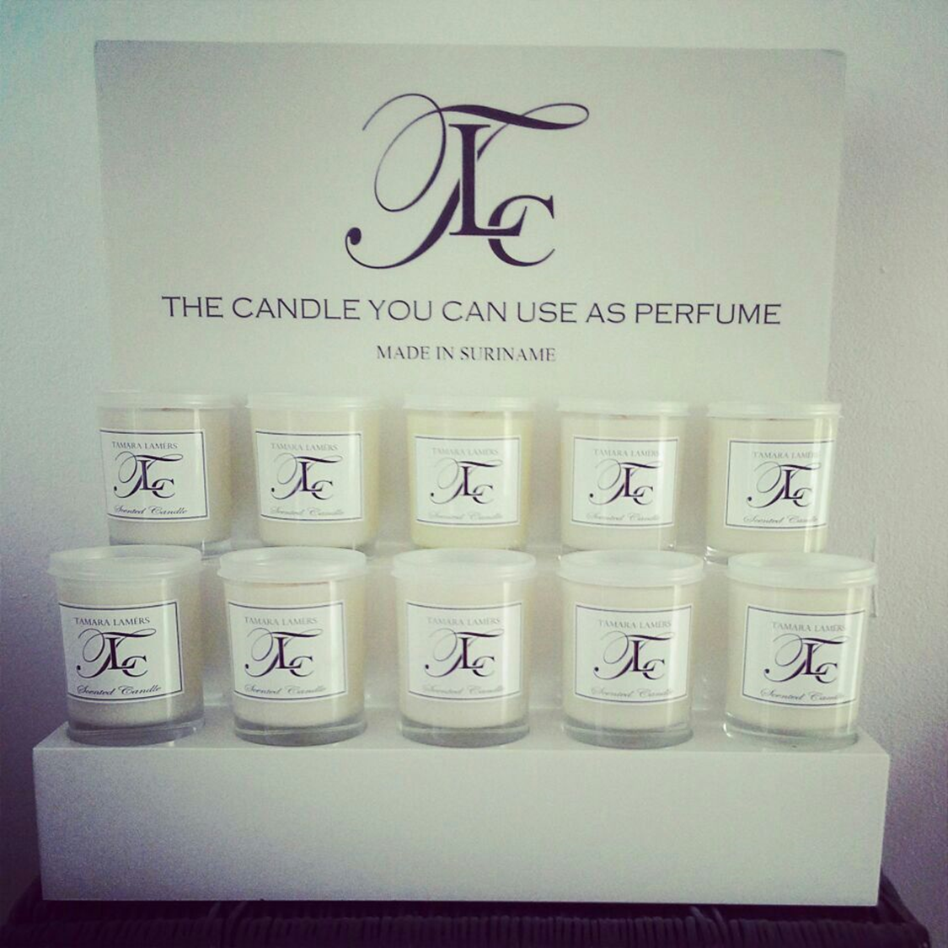
To here?
FabLab’s first visibility in the marketplace
:-D
was this display case… the candle sales went through the roof
!!!

Slide 12
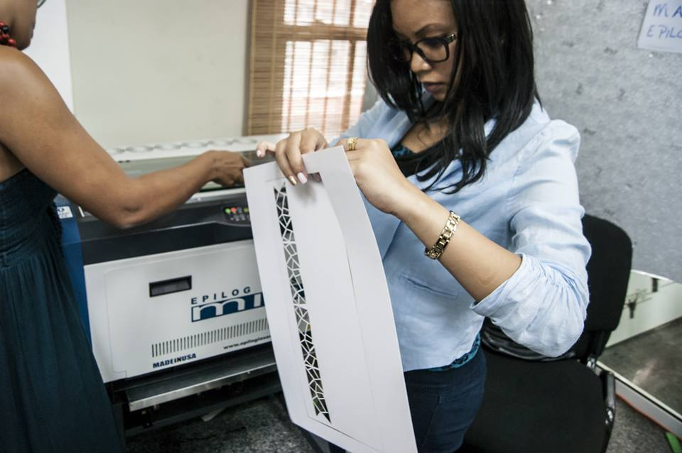
Going forward
Strengthen local and international partnerships
Capacity building (eg. MIT training, Makerfaires)
(Semi) independence

Slide 13
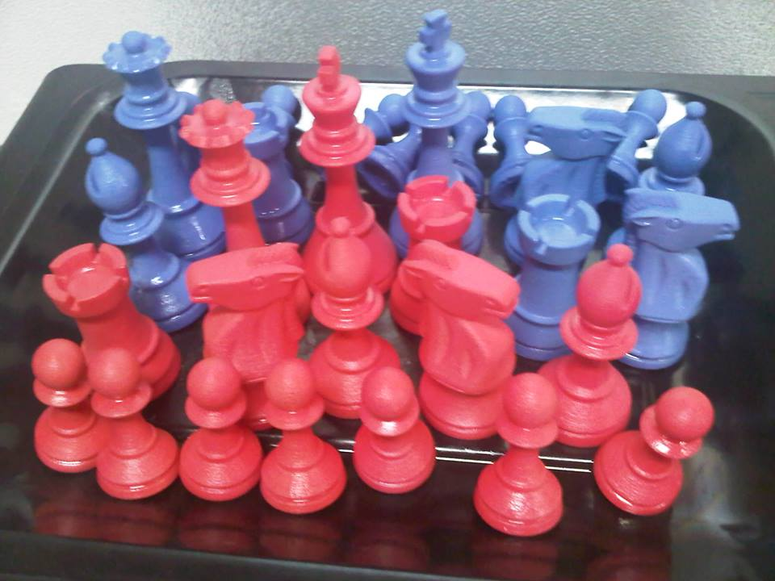
Going forward
Expand workshop portfolio
Country wide access, not just Paramaribo
Initiate research and business development projects

Slide 14
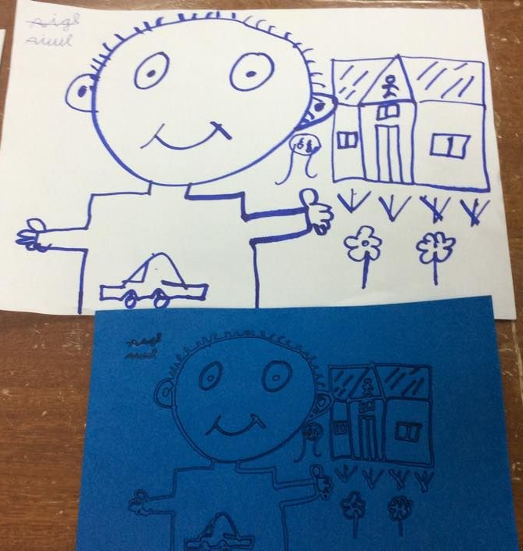

THANK YOU!
Fab Lab Paramaribo
Dr. S. Redmondstraat 116-118, Paramaribo
fablab@vicepresident.gov.sr
Mobile: +(597) 8858718/
+(597) 8322109
FabLab Paramaribo

