Slide 1

FAB FUTURES
Sherry Lassiter, Ed. M.
MIT Center for Bits and Atoms
& THE FAB FOUNDATION
Notes:
This proposal addresses workforce training for military field repair and maintenance, as well as in-theater equipment and part manufacture in ways that decrease dependence on remote supply chains and model-specific repair and maintenance approaches and increase technician ability to problem-solve and innovate in the field.

Slide 2
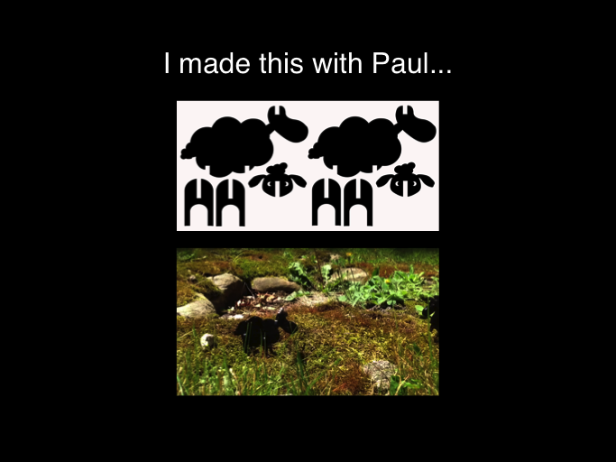
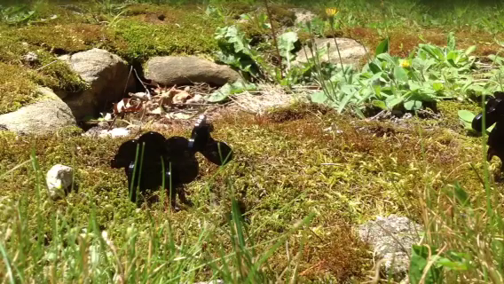

Slide 3
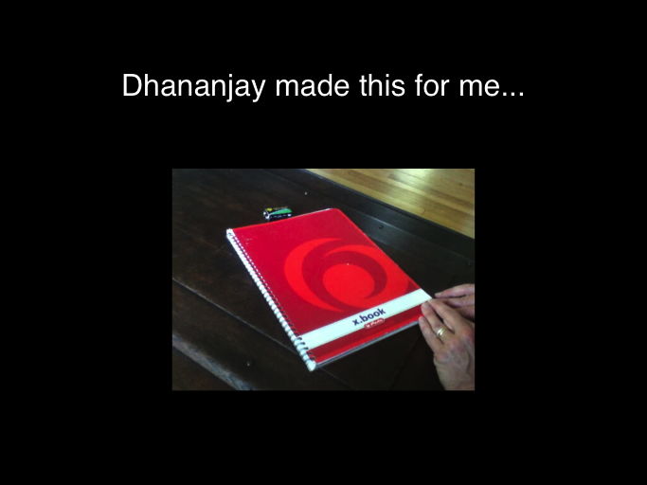
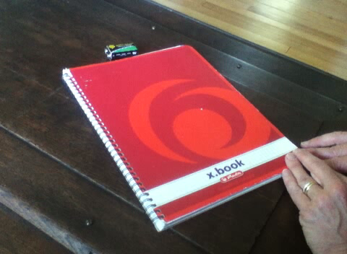

Slide 4
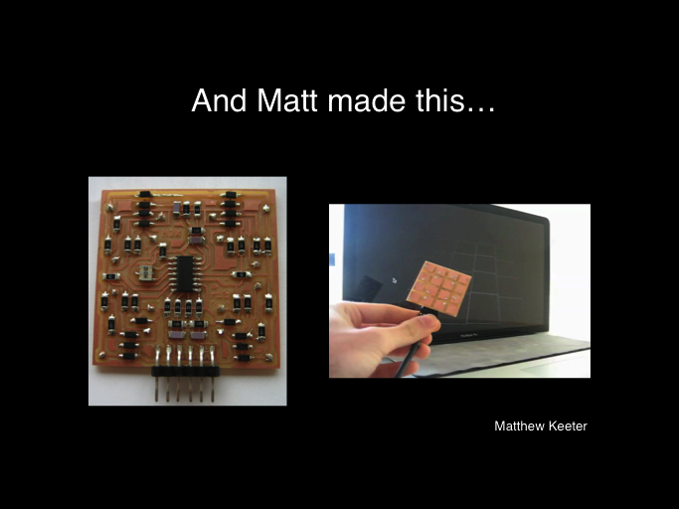
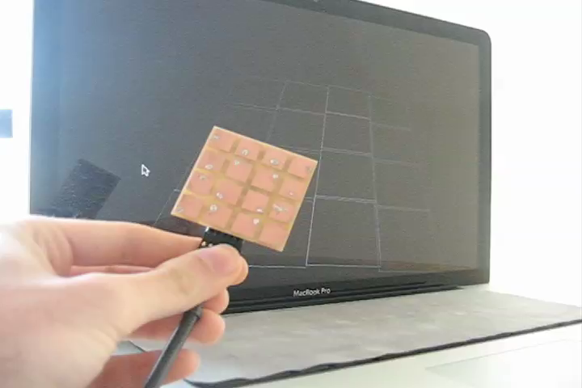

Slide 5

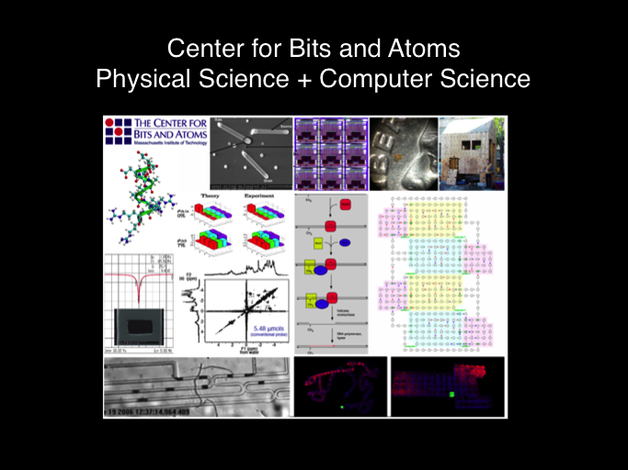

Slide 6
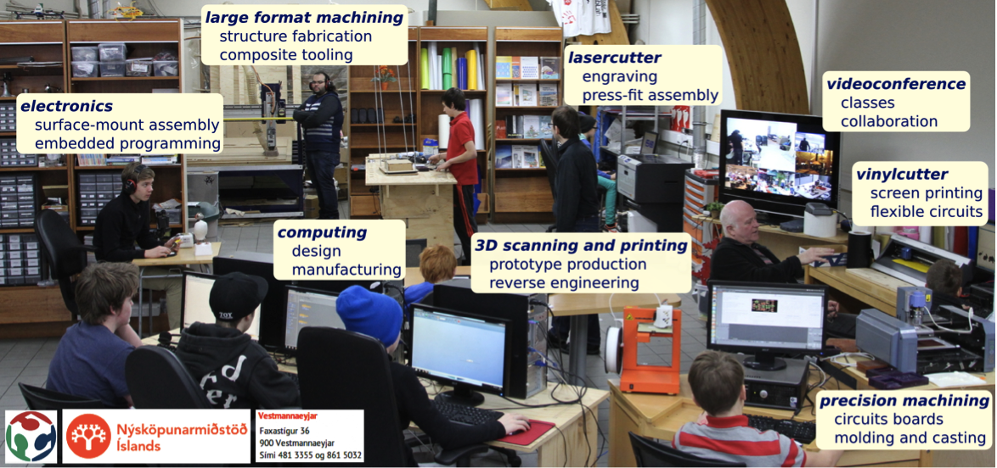
Fab Lab

Slide 7
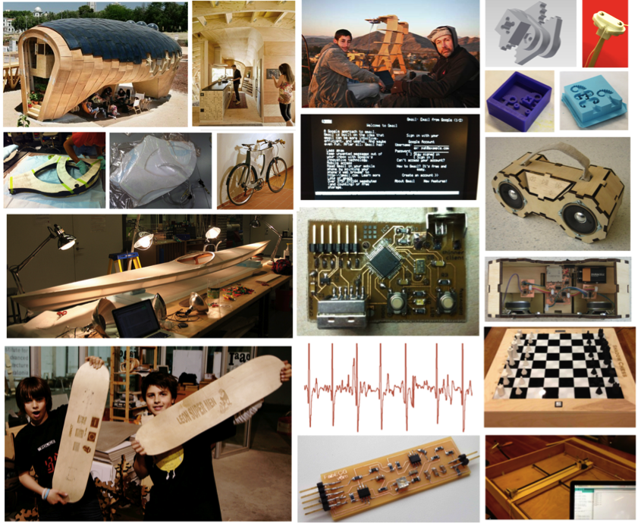

Slide 8
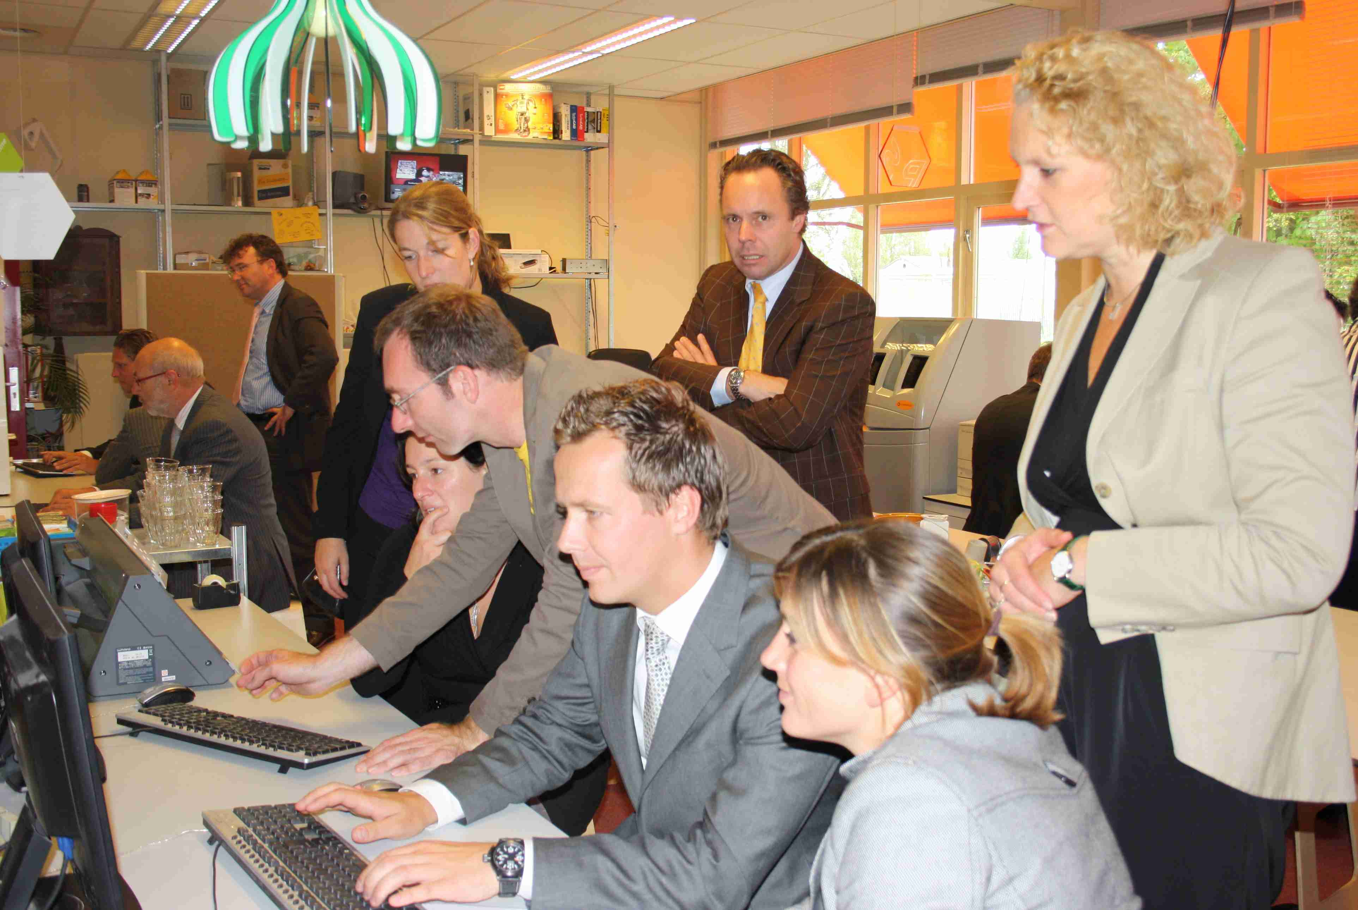
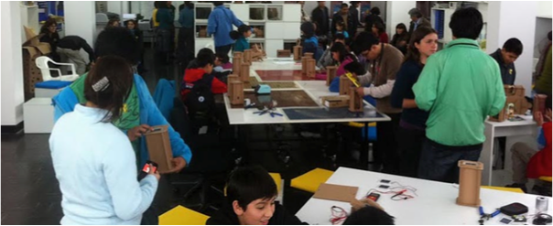
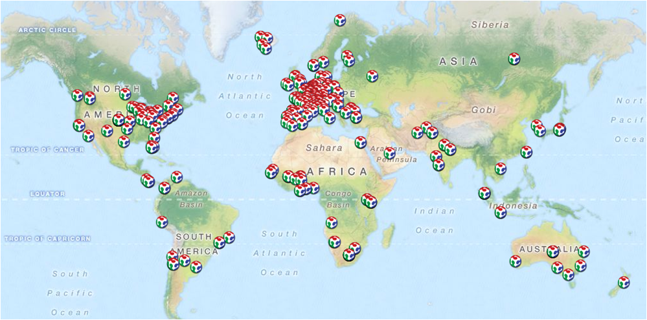
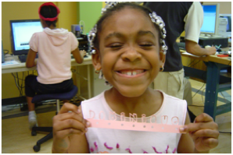

The Fab Lab Network:
A Distributed Network

Slide 9
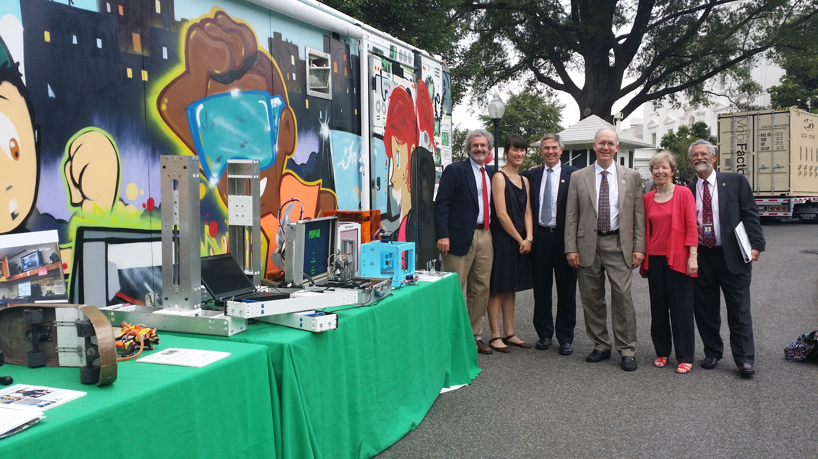
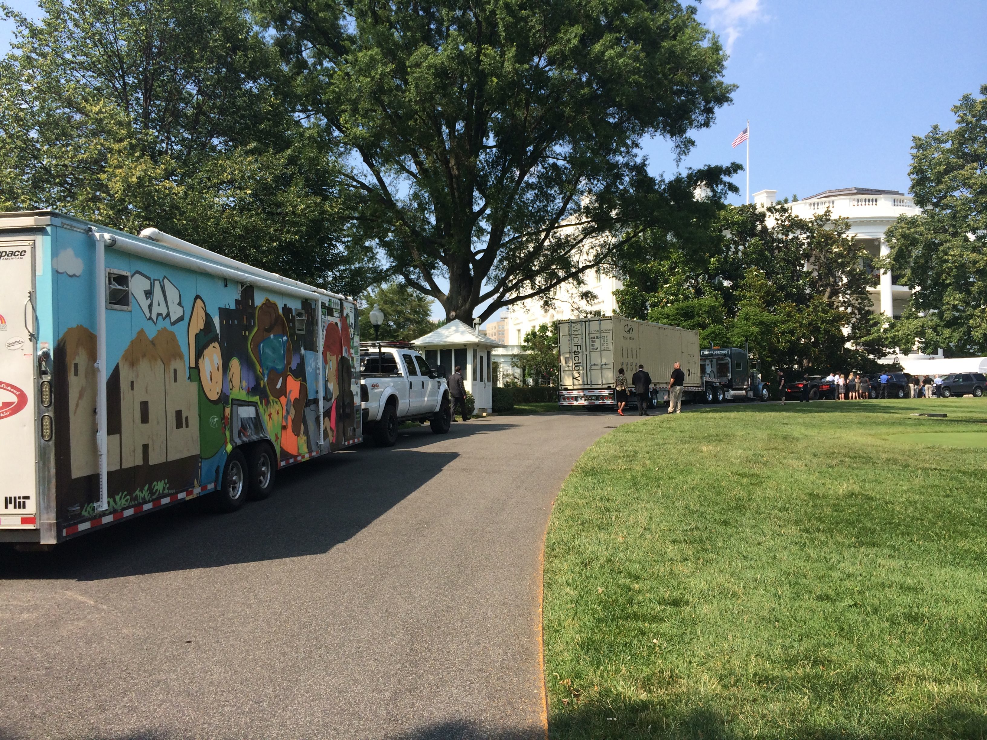
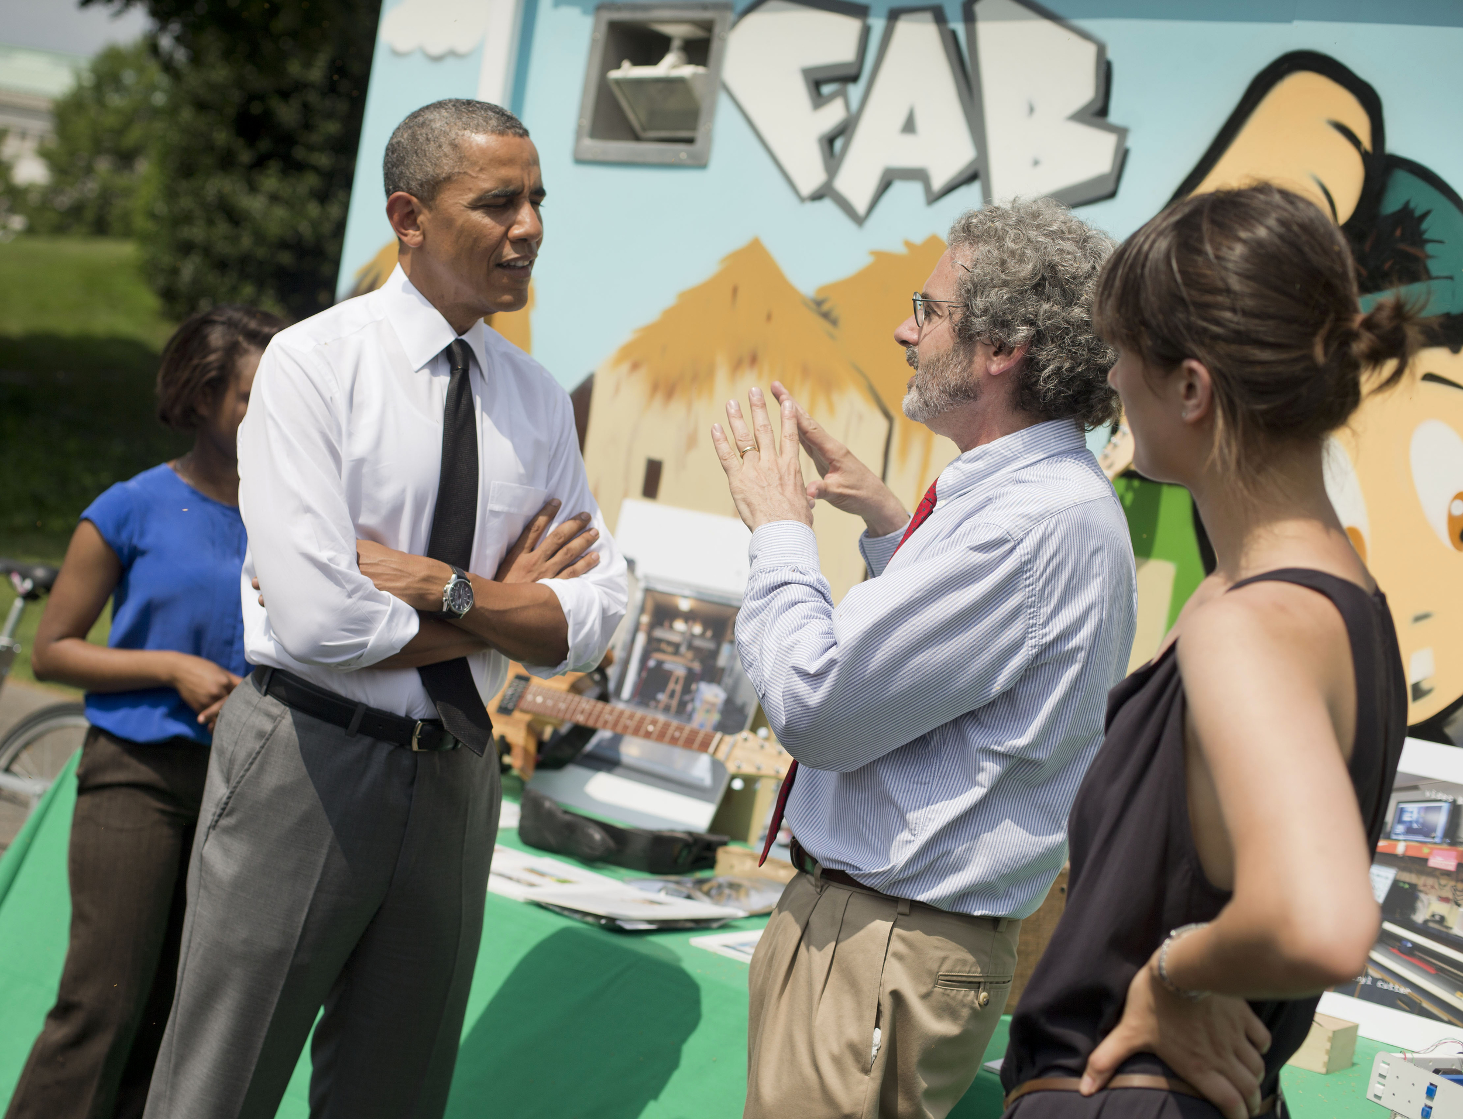
White House Maker Faire

Slide 10
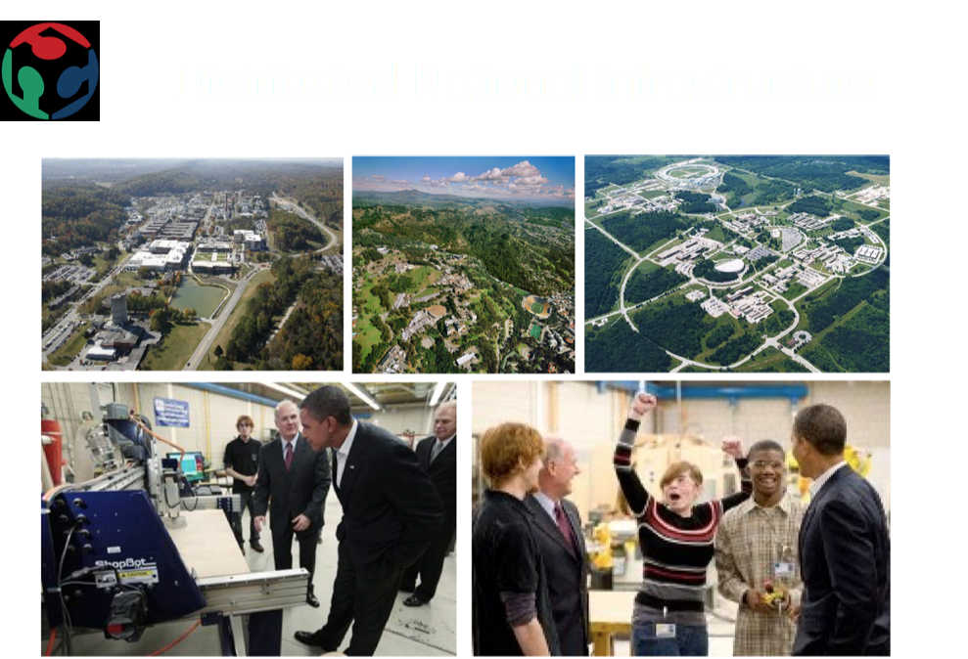

Slide 11
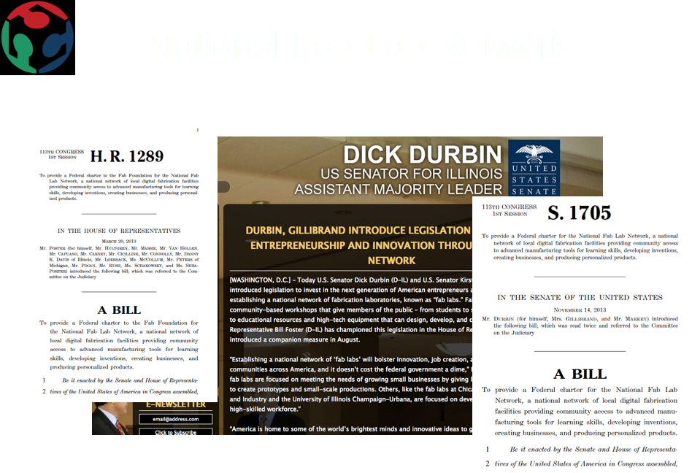
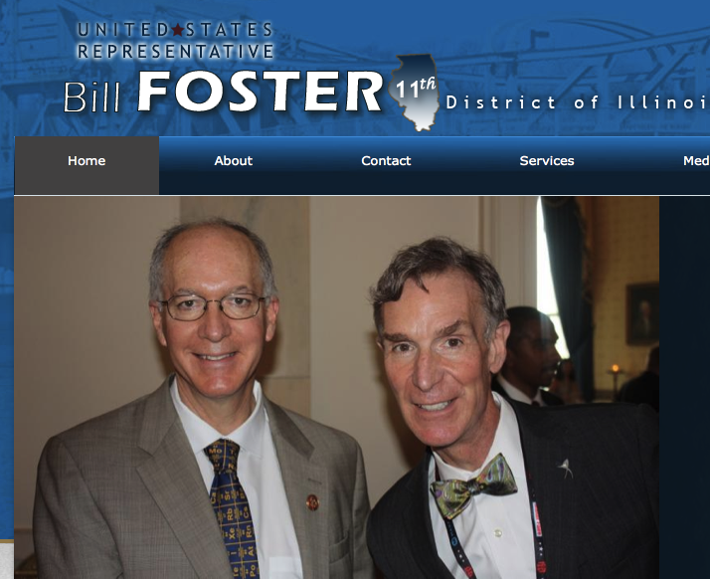

Slide 12
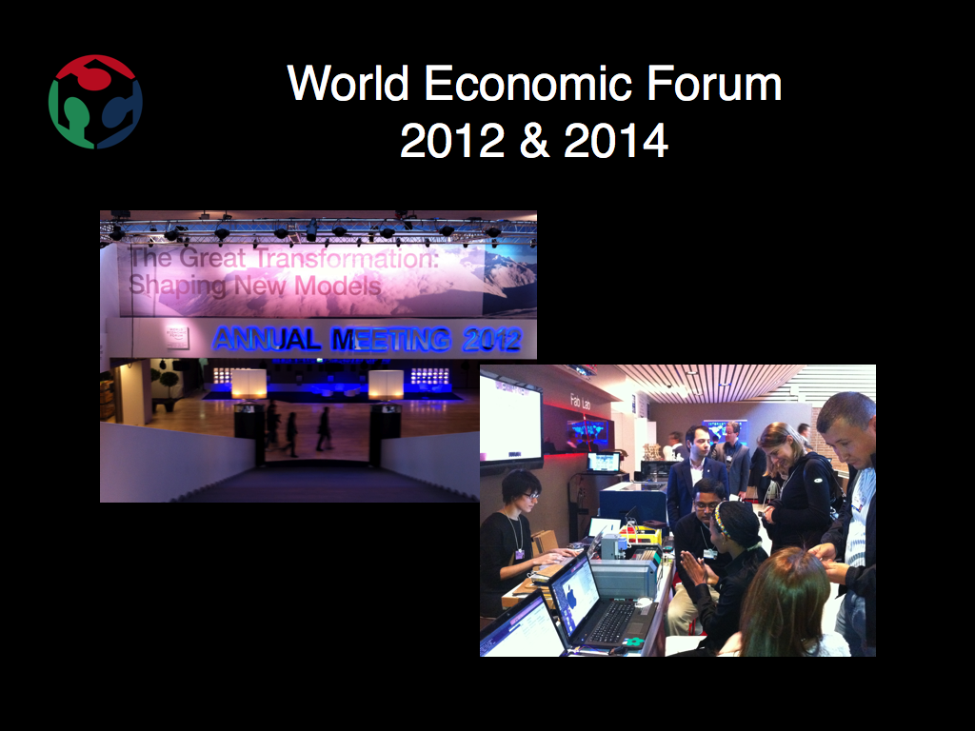

Slide 13
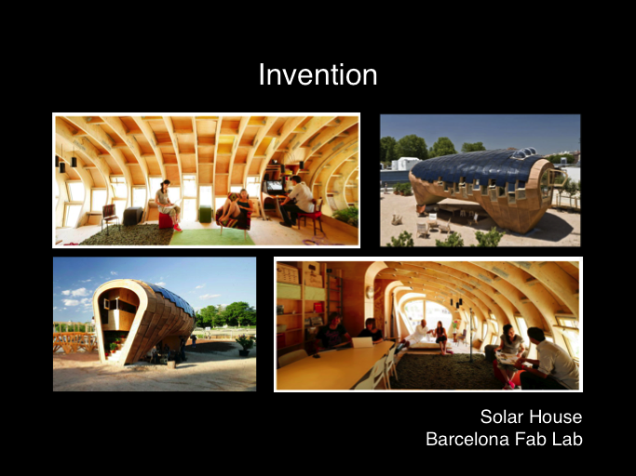


Slide 14
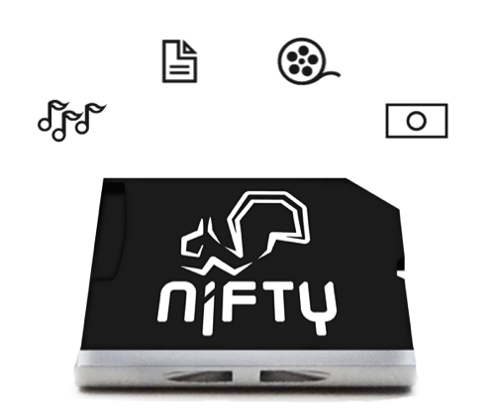
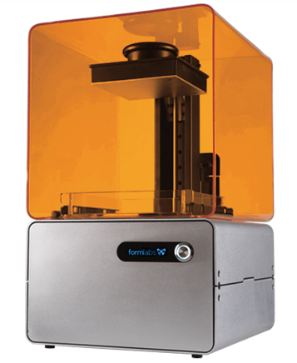
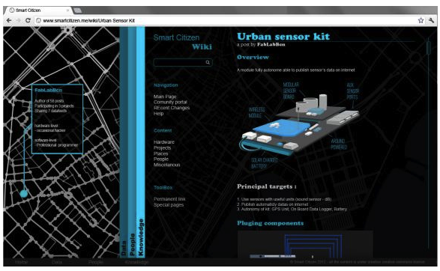
Invention
Smart Citizen Sensors
Form1

Slide 15
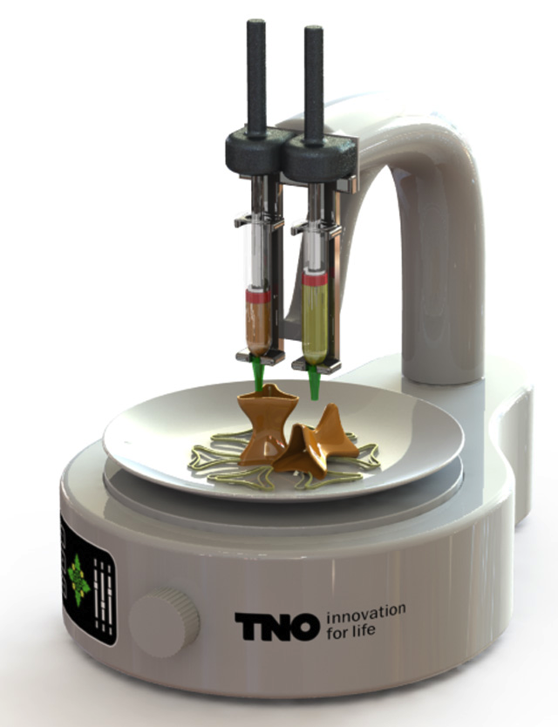

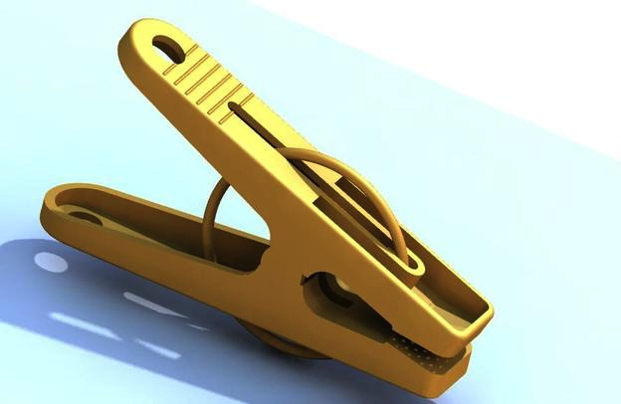
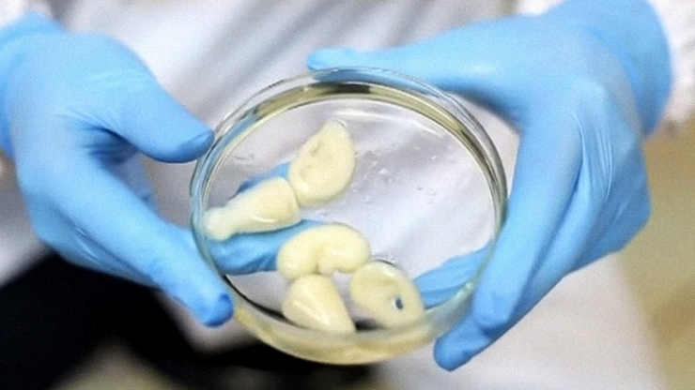
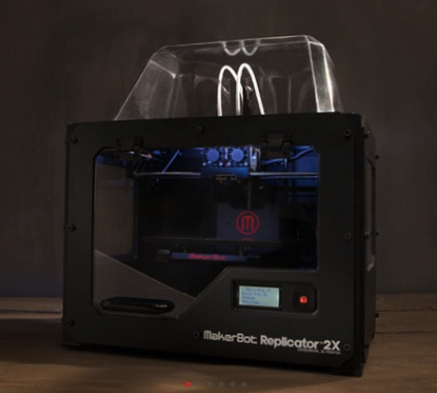
3D Printing
Tools
Food
Apparel
Body Organs
3D printer parts

Slide 16

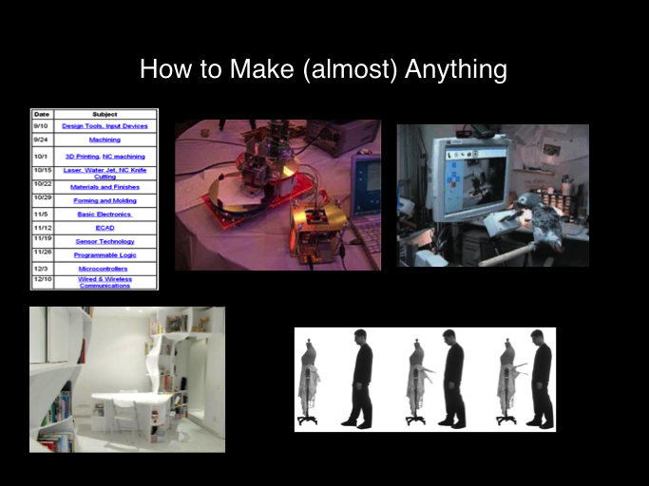
How To Make Almost Anything

Slide 17
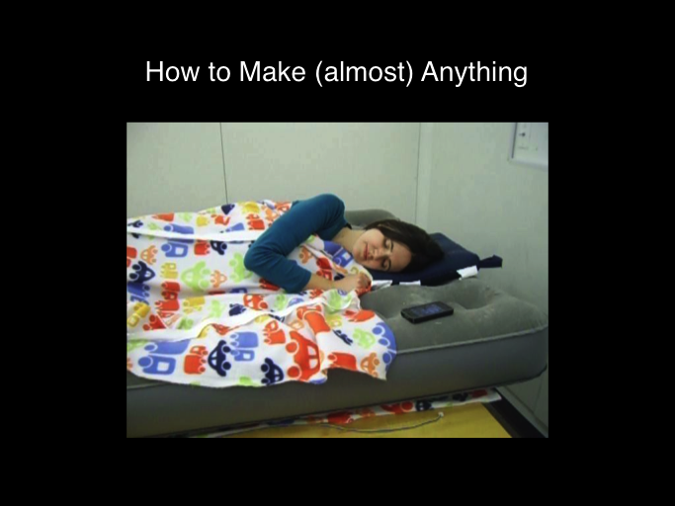
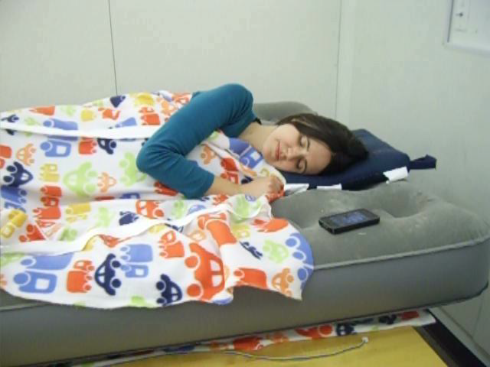

Slide 18
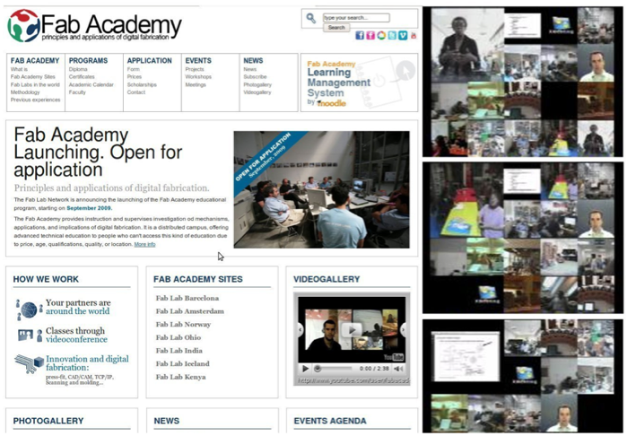
Fab Academy: A Global Campus

Slide 19
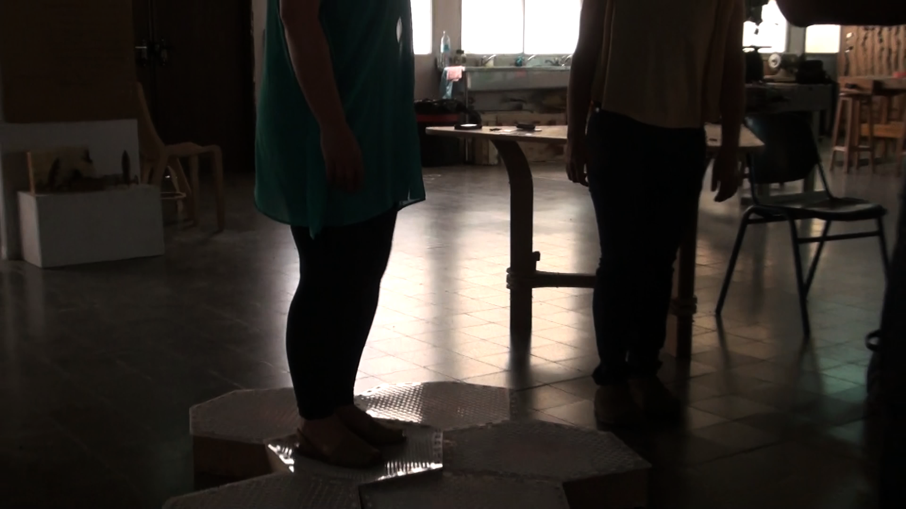
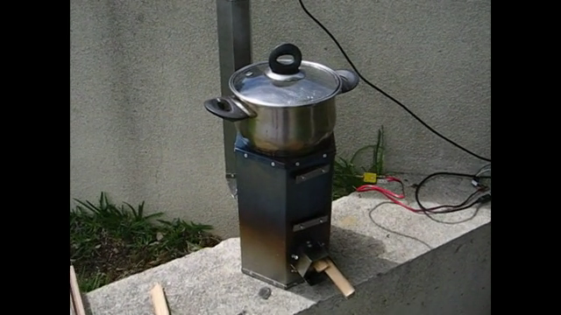
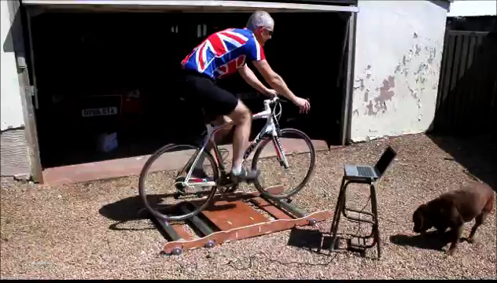
Fab Academy:
A Global Campus

Slide 20
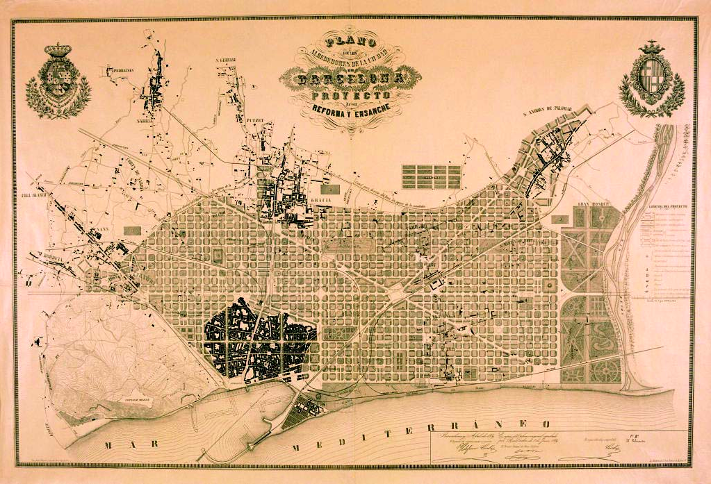

PiTo to DiDo
City of Barcelona

Slide 21
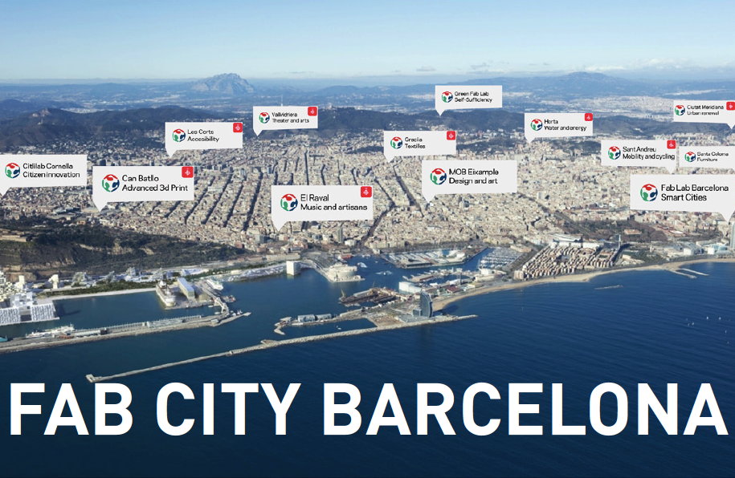
Fab City
Text

Slide 22

FAB11 Boston

Slide 23
MIT Center for Bits and Atoms
& THE FAB FOUNDATION
Sherry Lassiter, Director
Sherry.Lassiter@cba.mit.edu
Sherry.Lassiter@FabFoundation.org
http://fabfoundation.org
http://fab.cba.mit.edu

