Slide 1




Doing Business Reform Program Suriname
Stakeholders Involvement
Date : May 27, 2013
Time : 19.00 – 21.00 hours
Location : Auditorium Self Reliance

Slide 2
World Bank Doing Business measures business regulations across 185 economies using 10 Criteria and 34 sub-criteria
Indicator (Topic) | Sub-Indicators (Areas of assessment)
Starting a Business | Number of Procedures |  | Time (Num of days) |  |  | Cost (% of income per capita) |  |  |  | Paid-In Min Capital
Construction Permits | Number of Procedures |  |  | Time (Num of days) |  |  |  | Cost (% of income per capita)
Getting Electricity | Number of Procedures |  |  | Time (Num of days) |  |  |  | Cost (% of income per capita)
Registering Property | Number of Procedures |  |  | Time (Num of days) |  |  |  | Cost (% of income per capita)
Getting Credit | Credit Information Index |  |  | Legal Rights Index |  |  |  | Sum Getting Credit
Protecting Investors | Disclosure Index |  |  | Director Liability Index |  |  |  | Shareholders Suit Index
Paying Taxes | Number of Payments |  |  | Time (Num of hours) |  |  |  | Total Tax Rate (% of Profit)
Trading Across Borders | Number of Documents for Export | Time for Export (Num of Days) |  |  | Cost to Export (US$ per container) |  | Number of Documents for Import |  | Time for Import (Num of Days) |  | Cost to Import (US$ per container)
Enforcing Contracts | Number of Procedures |  |  | Time (Num of days) |  |  |  | Cost (% of claim)
Resolving Insolvency | Time (Num of Years) |  |  | Cost (% of Estate) |  |  |  | Recovery rate (Cents on the dollar)
Confirmed Indicator
Sub-Indicator (assessment area)
All criteria and sub-criteria are transparent and controllable, enabling economies to improve their ranking by instituting pro-business reforms
Notes:
Improvements to business regulation can require changes to:
Legislation,
Processes
Cost (generally based on GDP per Capita)

Slide 3
Doing Business Data is collected from Feb – Apr annually; reforms must be in place by this period
Current cycle has passed – For 2014 better coordination is required
Jan
Apr
May (W2)
May (W4)
Jul
Aug
Jan 2014
Feb 2014
Mar 2014
Apr 2014
May 2014
W2
W4
DB Data Collection
Coordinating Agency provides potential list of respondents to WB
WB releases Surveys to Govt & Non-Govt respondents
Coordinating Agency mobilizes and consolidates responses from Government agencies
Coordinating Agency submits responses from Government respondents to WB
Data Collection Methodology:
Questionnaires designed based on simple business case to ensure comparability across economies and time
Questionnaires are sent to government officials and industry experts - lawyers, business consultants, accountants, freight forwarders and professionals who routinely administer or advise on legal and regulatory requirements
Data from questionnaires are very stringently verified for consistency and checked against local laws and regulations where applicable
Where different estimates are received from multiple respondents, median values are used.

Slide 4

Suriname’s ranking according to:

Slide 5
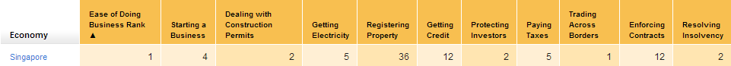
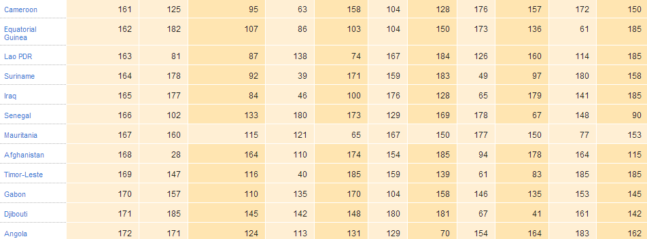
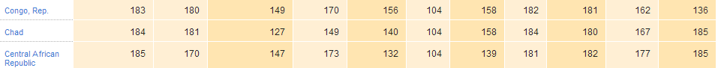
Suriname’s is ranked 164 out of 185 economies surveyed in Doing Business 2013

Slide 6
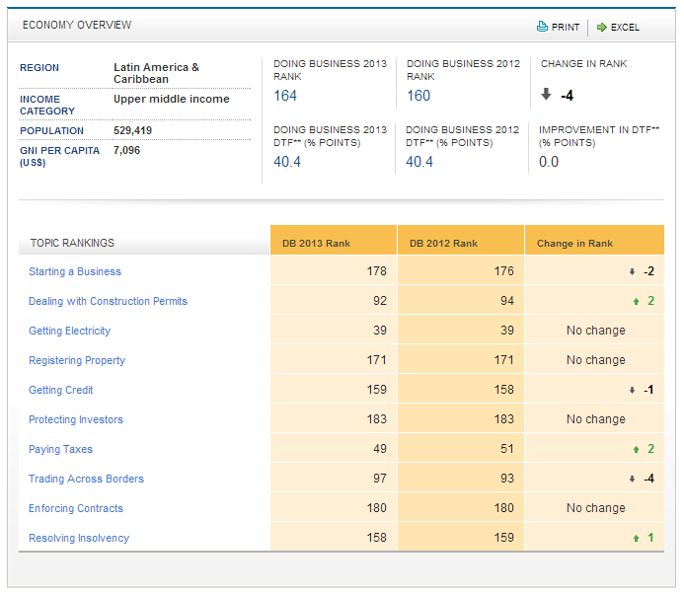
Suriname’s Performance in Doing Business 2013

Slide 7
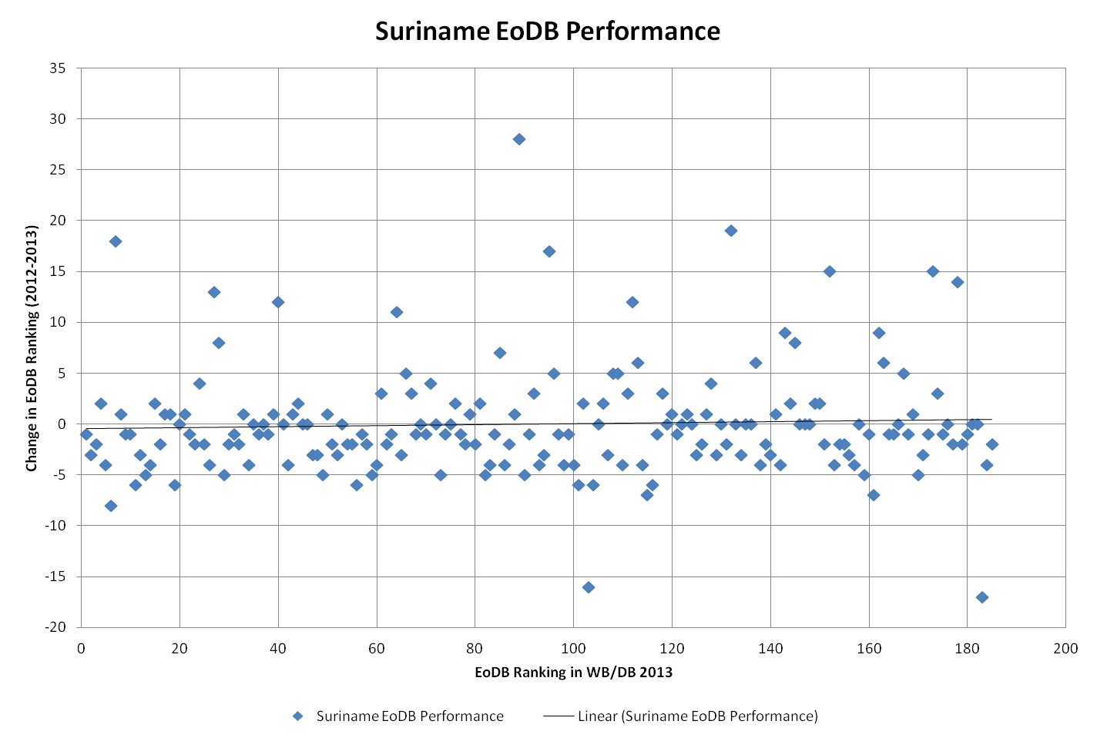
Suriname declined 4 ranks to #164 in Doing Business 2013
20% of 185 economies surveyed dropped 4 ranks or more
Suriname is among this 20%, placing us among the least business friendly places globally
Suriname is among the bottom 20% for:
  Starting a Business
  Registering Property
  Enforcing Contracts
  Protecting Investors
  Resolving Insolvency
  Getting Credit
Ranked near or below the Global Median in:
  Trading Across Borders
  Construction Permits
Suriname among the 20% economies that decline the most

Slide 8
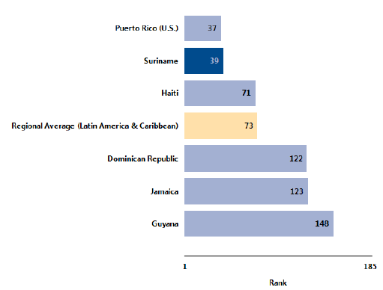
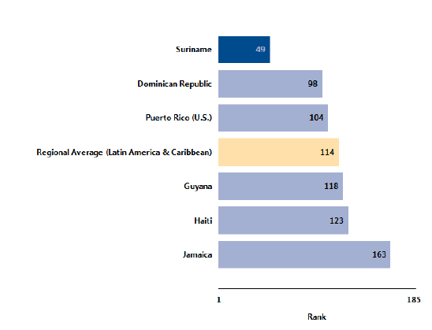
Suriname did well in some criteria but ...
Relatively easy for new businesses to Get Electricity – Suriname is ranked 39 of 185 in Ease of Getting Electricity
Doing Business 2013 also considers it easier to Pay Taxes in Suriname than 136 other economies – Suriname is ranked 49 of 185
Also been improvements in:
  Dealing with Construction Permits + 2 rank increase
  Paying Taxes + 2 rank increase
  Resolving Insolvency + 1 rank increase
BUT: Suriname’s Doing Business Rank Increases in some criteria were not a result of reform efforts but rather an increase in GDP (which brought down the Cost indicators) or rank decreases by other economies
Getting Electricity
Paying Taxes

Slide 9
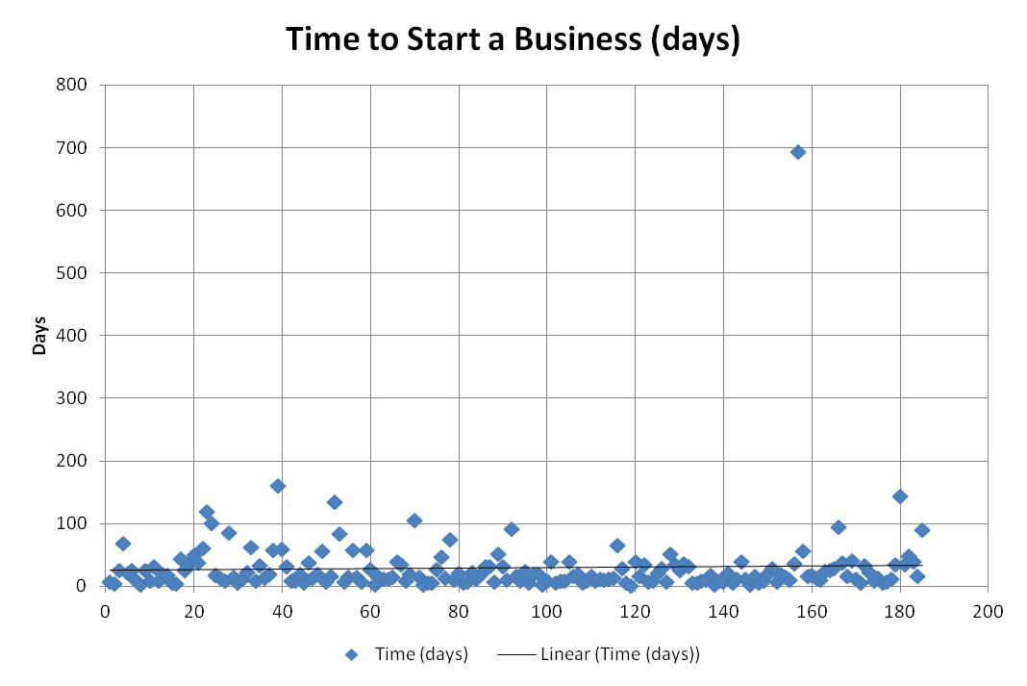
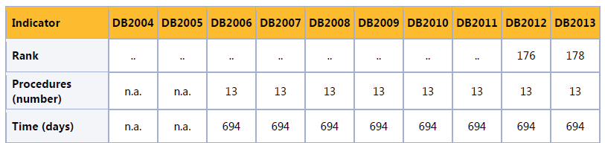
Immediate attention required in other areas ...
World Bank Doing Business still reports that it takes 694 days to Start a Business in Suriname
Next closest economy is Congo Republic (ranked 183), where it takes 161 days to Start a Business
By contrast, it only takes 20 days to Start a Business in Guyana and 105 days in Haiti
Suriname is the clear outlier
Next closest is Congo Republic

Slide 10


Past five years, Doing Business reported that Suriname did not improve but deteriorated
 | Starting a Business | Construction Permits | Getting Electricity | Registering Property | Getting Credit | Protecting Investors | Paying Taxes | Trade Across Borders | Enforcing Contracts | Resolving Insolvency
2009 | N | N | NA | N | N | N | N | N | N | N
2010 | N | N | NA |  | N | N | N | N | N | N
2011 |  | N | NA | N | N | N | N | N | N | N
2012 | N | N | N | N | N | N | N | N | N | N
2013 | N | N | N | N | N | N | N |  | N | N
DB 2010 – Suriname implemented new valuation requirements to insure proper tax payments at the Land Registry which increased procedures, cost and time to Register Property
DB2011 – VP reduced the time to under 21 days and simplified the procedures to Start a Business
DB 2013 - Suriname increased the time to export by involving more customs departments in clearing exports, making it more tedious to Trade Across Borders
NA – Not Assessed
Positive Reforms
N – No Reform
Negative Reforms

Slide 11
Expected Output
Policy reforms that drive a pro business environment
A Doing Business Diagnostic Study (Phase 0) and Identification of Quick Wins (Phase 1)
Set of medium term reform plans based on recommendations from Diagnostics Study (Phase 2)
Institutional long term reforms plans (Phase 3)
A Doing Business management process and governance structure

Slide 12
What is expected from stakeholders?
Assistance to identify, validate, prioritise areas for reforms to reduce time and cost and strengthen governance and ICT
Co-encouragement and ownership for implementation of the roadmap for reform
Promotion and support by strategic stakeholders and process owners to keep improving

Slide 13
GOAL DB Reform Program
Together with stakeholders establish an enabling environment for Doing Business, that promotes an Entrepreneurial Society and contributes to the sustainable strengthening of the national competitiveness, consequently improving the international ranking of our Country.

Slide 14

is now...

Slide 15
Thank you
www.surinamecompete.org

