Slide 1

Suriname: The Institutions that Matter for Diversification
Francisco G. Carneiro

Slide 2
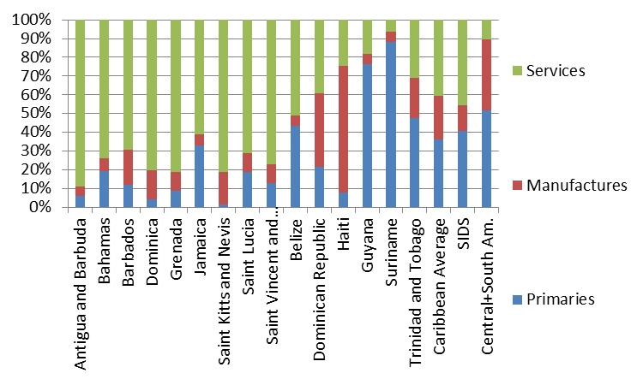
Suriname’s exports are highly concentrated on primary goods
Source: WBG staff calculation based on UNCTAD Stats - Pinies, Varma and Wacker (2015), Stylized Facts in the Caribbean. Primaries include SITC 0 to 4+68+667+971; Manufactures include SITC 5 to 8 less 667 and 68. Data for 2012 (2011 for service data in Barbados and Trinidad and Tobago).

Slide 3
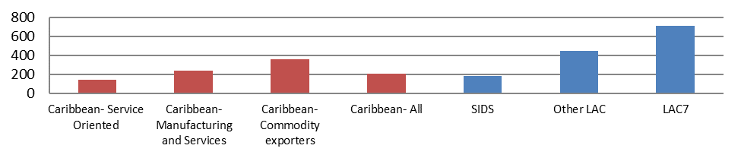
In the Caribbean, commodity exporters tend to have the highest levels of diversification
Number of export lines shows the total number of goods and services exports in 2007. Services are Communications, Financial Services, Transport and Travel Services. Goods exports correspond to 4 digits classification of SITC Revision 2. Bar shows the group mean. Other LAC refers to Latin America excluding Caribbean countries. LAC7 refers to the seven largest economies of Latin America (Argentina, Brazil, Chile, Colombia, Mexico, Peru and Venezuela). Sources: WDI and WITS, Pinies, Varma and Wacker (2015), Stylized Facts in the Caribbean.

Slide 4
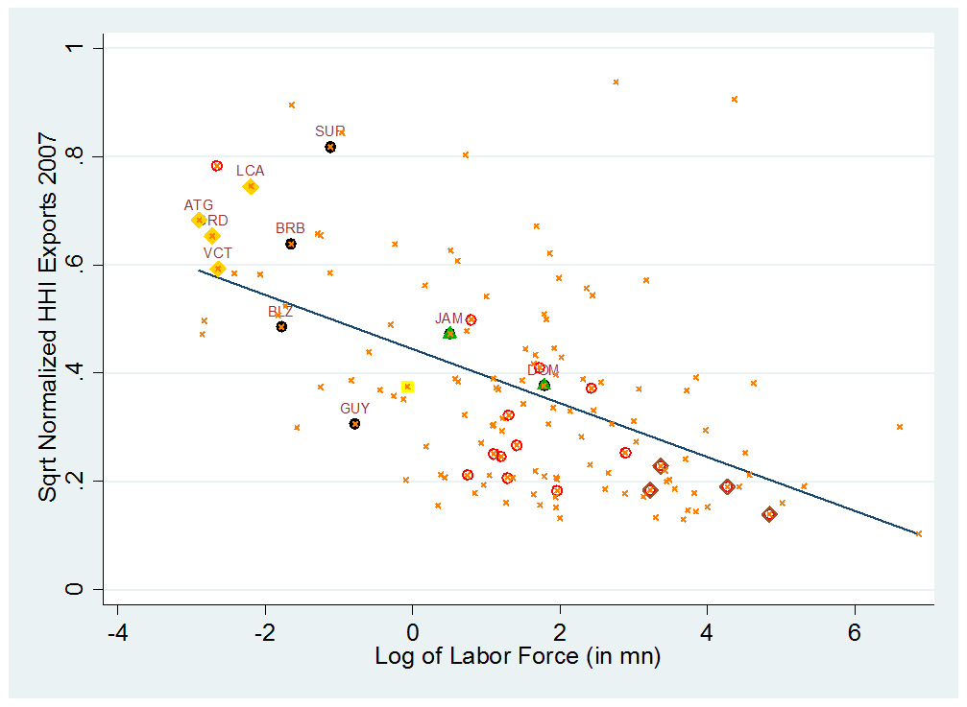
Suriname remains an outlier in comparison with others in the Region
The square root of the normalized Herfindahl Index for Exports of Goods and Services for 2007 is a measure of exports concentration. Services included are Communications, Financial Services, Transport and Travel Services. Goods exports correspond to 4 digits classification of SITC Revision 3. Black correspond to Caribbean countries; Gold to OECS countries; Green to Dominican Republic & Jamaica; Yellow to Trinidad & Tobago; Red to Other LAC; Sienna to Large LAC (Argentina, Brazil, Colombia & Mexico) and the orange crosses represent the rest of the countries. The blue line is the fitted line (linear). Sources: WDI and WITS, Pinies, Varma and Wacker (2015), Stylized Facts in the Caribbean.

Slide 5
Elements of a Successful Growth Model
Economic Prosperity & Diversification
Assets
Policy Levers
Management of Risks

Slide 6
Assets
Natural Capital
Physical Capital
Human Capital
Institutional Capital

Slide 7
Policy Levers
Volatility Reducing
Productivity Enhancing
Employment Creating

Slide 8
Institutions that Matter
Mobility
Migration
Spatial Policy
Social Contract
Inclusive Growth
Distributional Issues
Service Delivery
Energy, water, land, health, education, public administration
Business Environment
Financial sector, competitiveness, sophistication of business strategy & operations, technological readiness
Macroeconomic Management
Volatility reducing, role of the state, sources of growth

Slide 9
conclusion
Suriname is an outlier in the region in that it is a commodity exporter, but one with low levels of export diversification
There are therefore plenty of opportunities to develop other product lines and diversifying
A sustainable growth model that is conducive to diversification requires strengthening of market and public institutions
The institutions that matter are those that can help and not hinder public service delivery; the business environment; and macroeconomic management

Slide 10
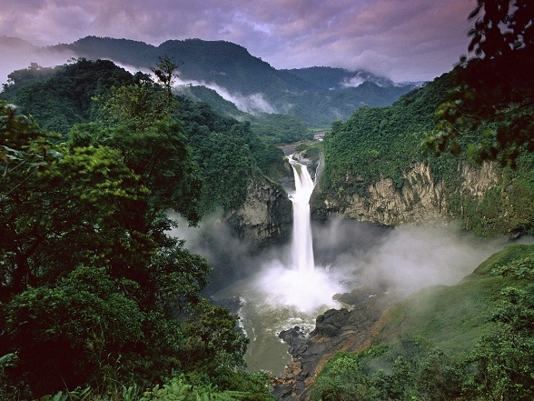
Thank You

