Slide 1
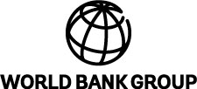
Suriname: What Policy Reforms Work Best for Diversification
Francisco G. Carneiro

Slide 2
A rapidly growing small open economy with a high income per capita
Population (millions)..........................................0.5
GDP (US$ billions)............................................. 4.7
GDP per capita (US$).................................... .8,686
GDP (PPP) as share (%) of world total............. 0.01

Slide 3
Natural resources are the main source of growth and vulnerability
Mostly urban population (69 percent) with the capital city, Paramaribo, concentrating close to 50 percent of the population
Poverty (estimates range from 20 to close to 50 percent) and inequality (Gini coefficient of 0.52) appear to be high with anecdotal evidence of high incidence among the indigenous populations – however, the methodology used to measure poverty and inequality is not conventional
Growth has been robust averaging 4.4 percent per year since 2000 but has been driven mostly by exports of commodities such as gold, alumina, crude oil, and bananas
Gold alone accounts for 2/3 of total exports and 13 percent of fiscal revenues; fiscal exposure to oil is also important as it represents close to 30 percent of total revenues
A concentrated export structure suggests lack of diversification of products and markets; main trade partners are US, Belgium, UAE, and Canada – very little trade with the rest of South America, for example
Bottomline: Growth has not led to shared prosperity and has been mostly driven by natural-resource exports making the country overly exposed to commodity price volatility

Slide 4
The public sector plays a significant role in the economy but it is not very efficient
Significant presence of the state in the economy through state-owned enterprises (SOEs) that are involved in economic and regulatory activities – many of these SOEs are loss making
Public sector employs 60 percent of the active work-force, and the overall governance and most specific sectoral frameworks are outdated
The efficiency of the economy is jeopardized by the out of date governance framework
Most indices of competitiveness suggest that economic efficiency in Suriname is hampered by excessive and inefficient government regulation, weaknesses in transparency and accountability
Bottomline: If it is politically difficult to reduce the size of the public sector, efforts should be made to make it more efficient

Slide 5
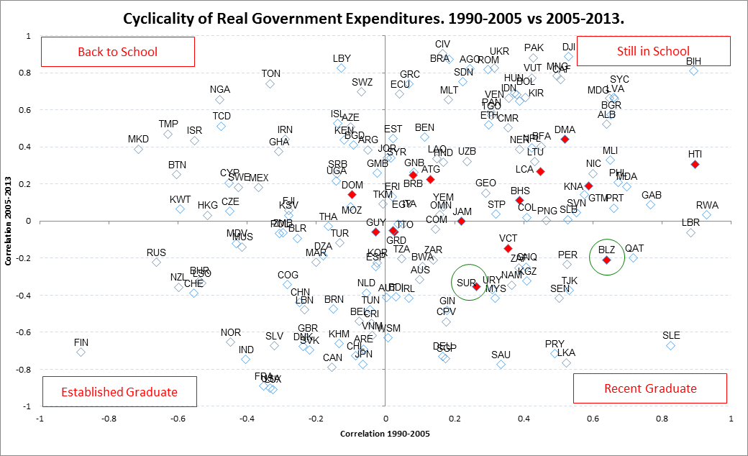
Pro-cyclicality of fiscal spending does not help

Slide 6
Different regions have used different strategies to integrate into the world
(export products, by factor intensity, in Eurasia, EU12 and East Asia)
Note: Factor intensity is measured with the export data classified by SITC Revision 1. The modified version of commodity classification by Krause (1987) is used. Resource intensive includes products related to hydrocarbon and minerals only. Goods related to agriculture are contained in labor intensive (unskilled labor intensive). Here, capital intensive is represented by both technology intensive and human capital intensive.
Source: World Bank staff calculations based on UN Comtrade.

Slide 7
What kind of diversification should be pursued
Partners
Products and Services
Assets
Physical Capital; Human Capital; Institutional Capital
Employment Creating
Productivity Enhancing
Volatility Reducing

Slide 8
Diversifying as an outcome of economic development
Shared Prosperity
Diversification
Development Outcomes
A More Prosperous Suriname
Improved Living Standards for All
Diversification of Products and Partners
Volatility Management
Labor Skills
Productivity
Factors Affecting Competitiveness
Resource dependence is not a curse
Policy levers

Slide 9
What should be the focus of policy?
Public Sector Efficiency
Rationalization of public spending and reduction of SOE losses
Strengthening of public financial management
Competitiveness
Improvements in the business environment; financial sector development; vocational training
Value chain analysis to understand market and coordination failures
Environmental Sustainability
Strengthening of capacity for counter-cyclical fiscal policies
Improve education outcomes and skills
Infrastructure resilience
Flood prevention and erosion control
Sustainable practices in the extractive industries

Slide 10
conclusion
Suriname is a resource-rich economy with a huge development potential
Resource-dependence is not a curse and could be the pathway to a more prosperous economy
Diversification should not be an obsession but rather as an outcome of economic development
Policy reform should focus on reforms with the greatest potential to reduce volatility; promote productivity growth; and enhance competitiveness

Slide 11

Thank you

